Slide 1
2024 IDO Summer School Program Sharing
The London School of Economics and Political Science
WANG YI, Digital Social Science,
Faculty of Humanities and Social Science

Slide 2
TABLE OF CONTENTS
01
02
Course
Academic Atmosphere
03
04
Entertainment
Feelings
暑期学校课程介绍
在LSE的学术氛围感受
暑期学校期间的衣食住行➕娱乐
个人感受➕未来升学

Slide 3
01
COURSE INTRODUCTION
暑期课程介绍

Slide 4
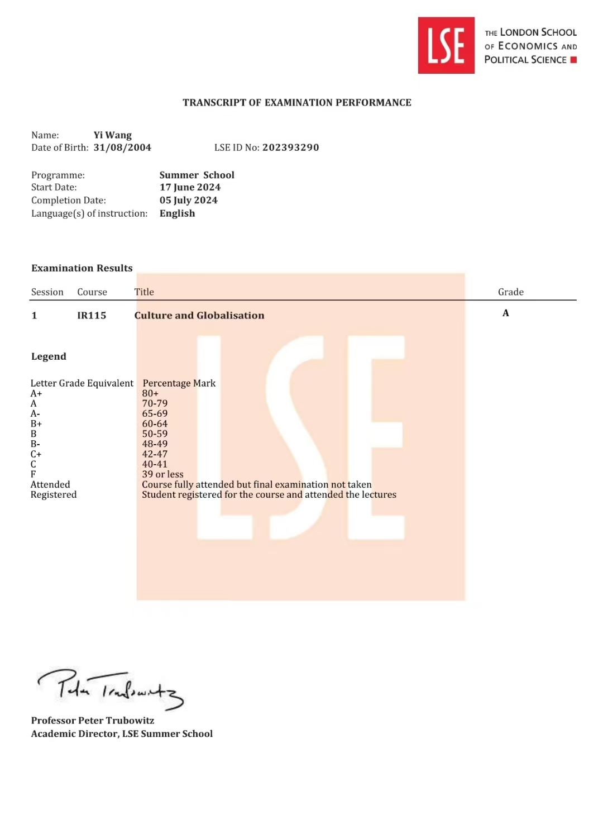
1.1 My choice for summer school course
IR115 Culture and Globalization
文化人类学相关课程（taught by the Department of Anthropology in LSE)
2000 words essay (50%)
Final exam (50%)
Lecture ➕ Seminar
My final grade: A

Slide 5
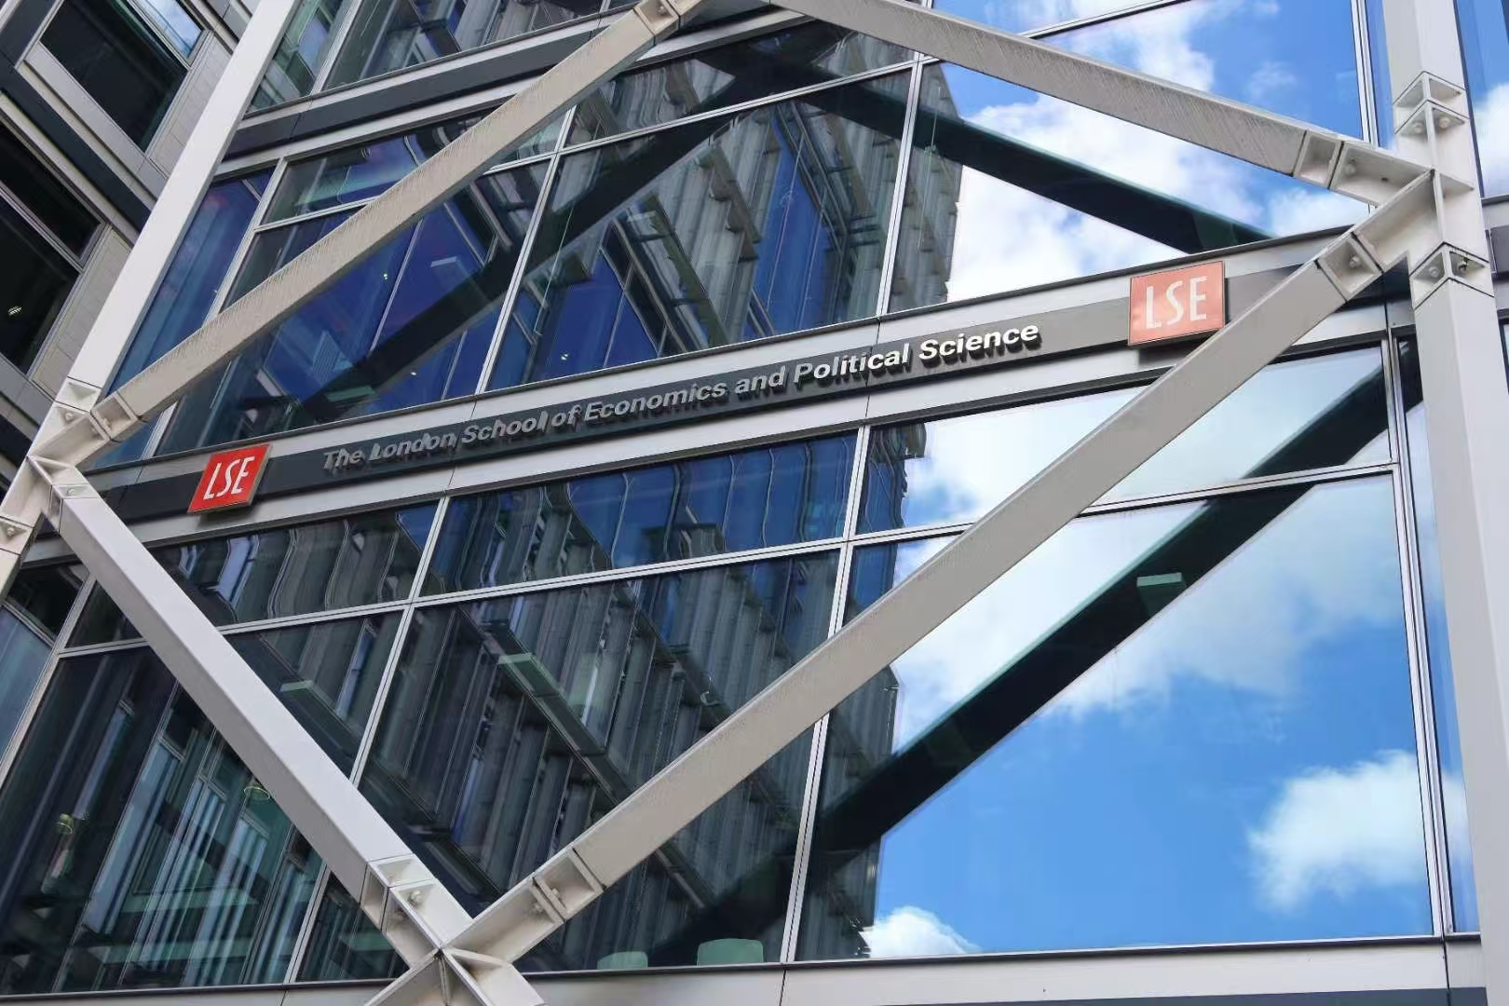
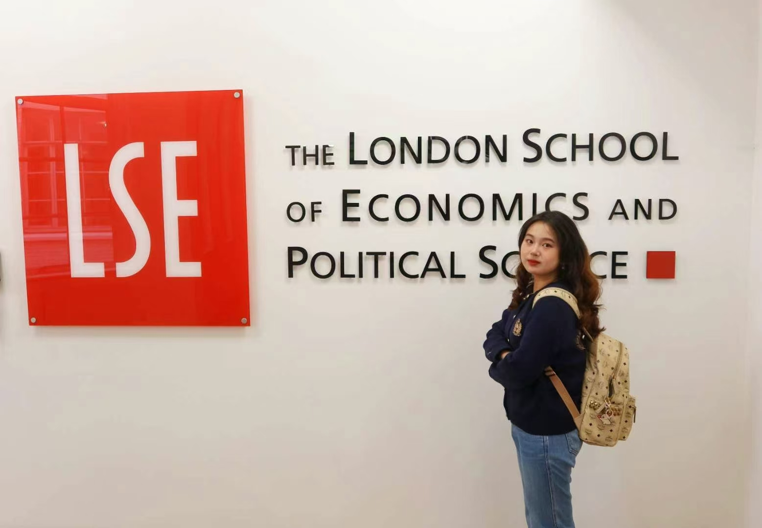
1.1 My choice for summer school course

Slide 6
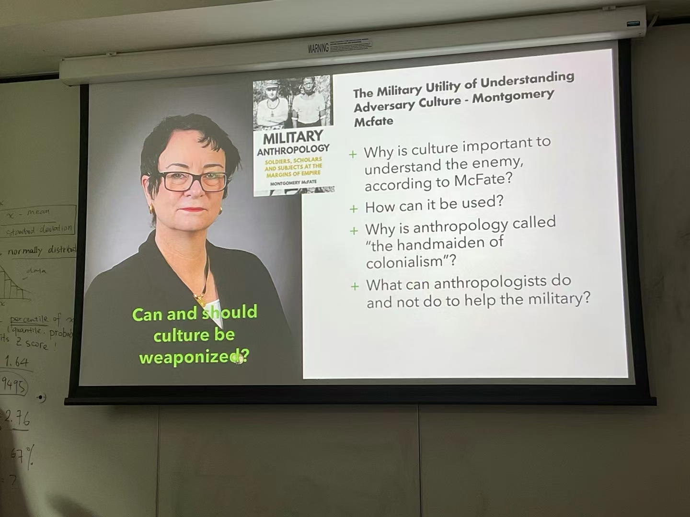
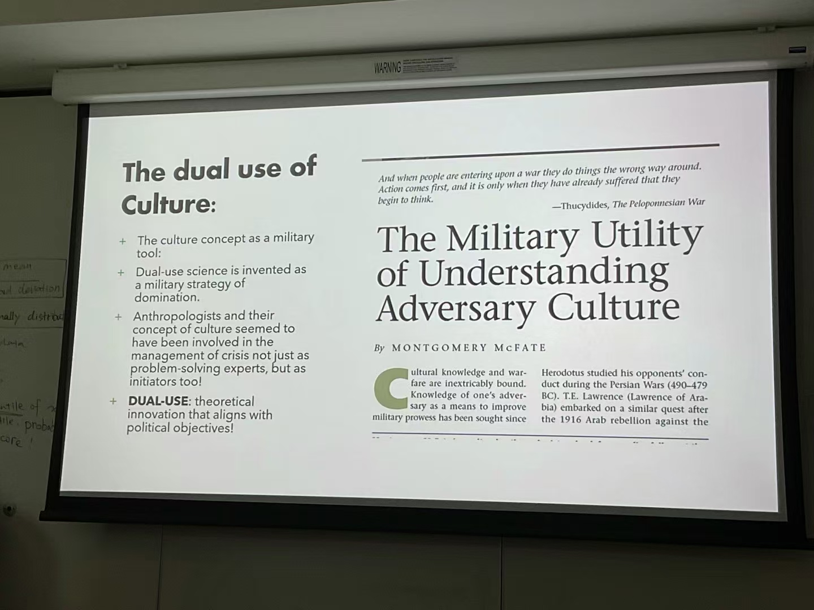
1.1 My choice for summer school course

Slide 7
02
ACADEMIC
ATMOSPHERE

Slide 8
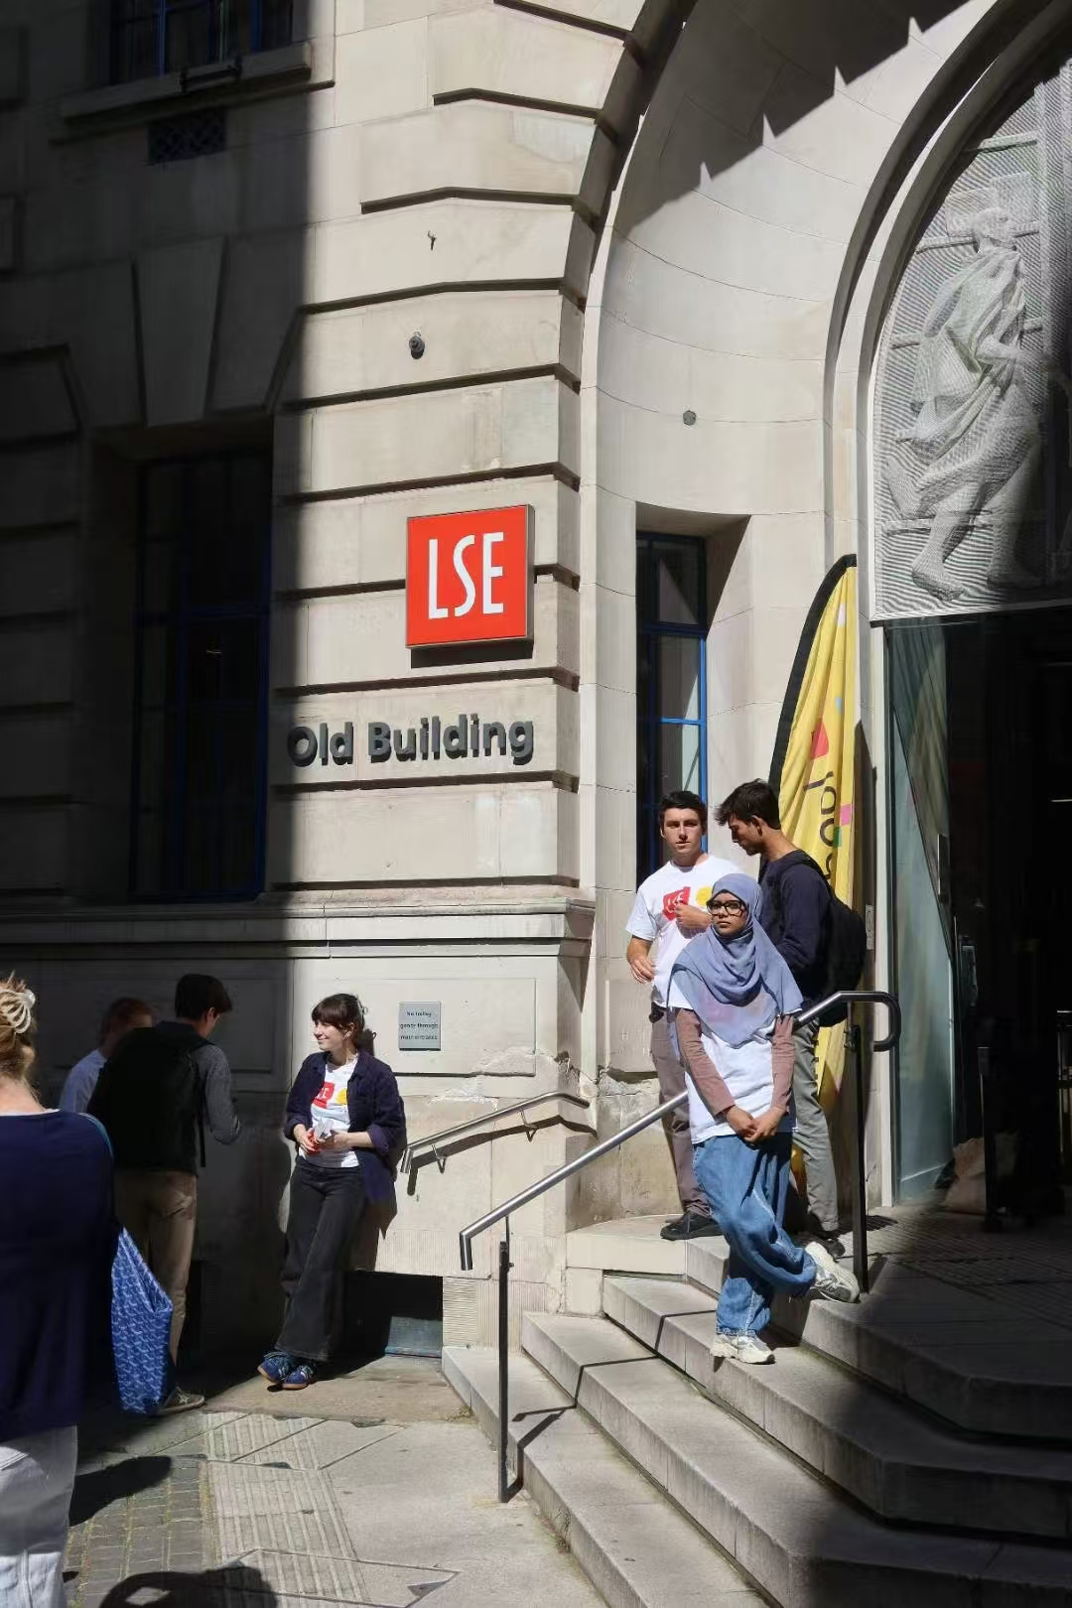
2.1 Academic Atmosphere in LSE
“女神校” 商科社科强校
Strong academic resources
Very academic training (good for those wanna work in academic
Beautiful school ➕ Good location (central in London)

Slide 9
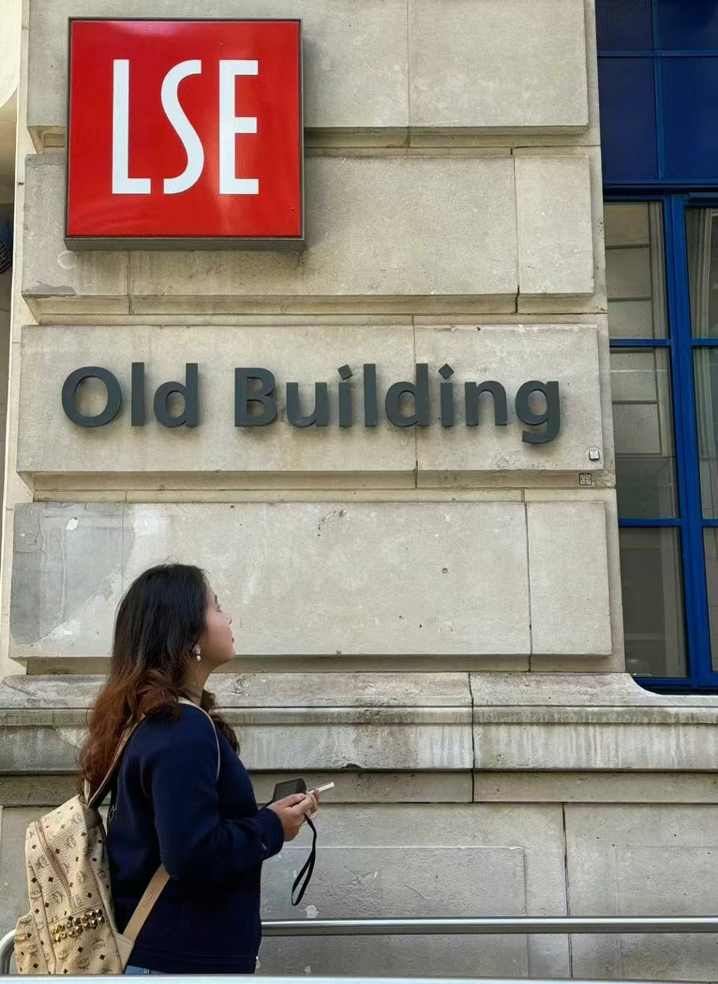
2.1 Academic Atmosphere in LSE
对于犹豫是否进入学术领域的同学
对于不确定自己是否适合🇬🇧教育体系的同学
Recommended for attending this summer school

Slide 10
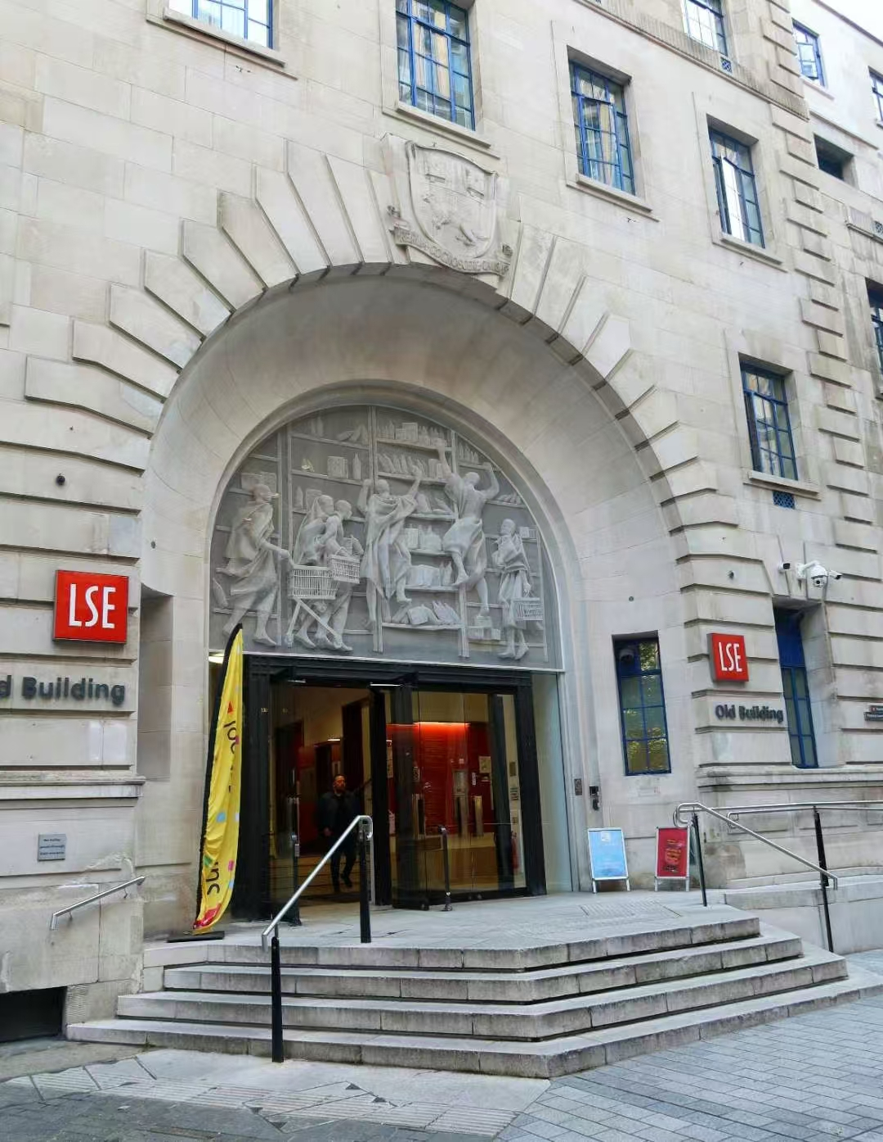
2.1 Academic Atmosphere in LSE
Strick Academic Requirements
Heavy workload
(Readings !!!!!!!!!!!)
非常非常多的，阅读！！！
Critical Thinking and Expressing Individual Ideas (in seminars)

Slide 11
03
ENTERTAINMENT

Slide 12
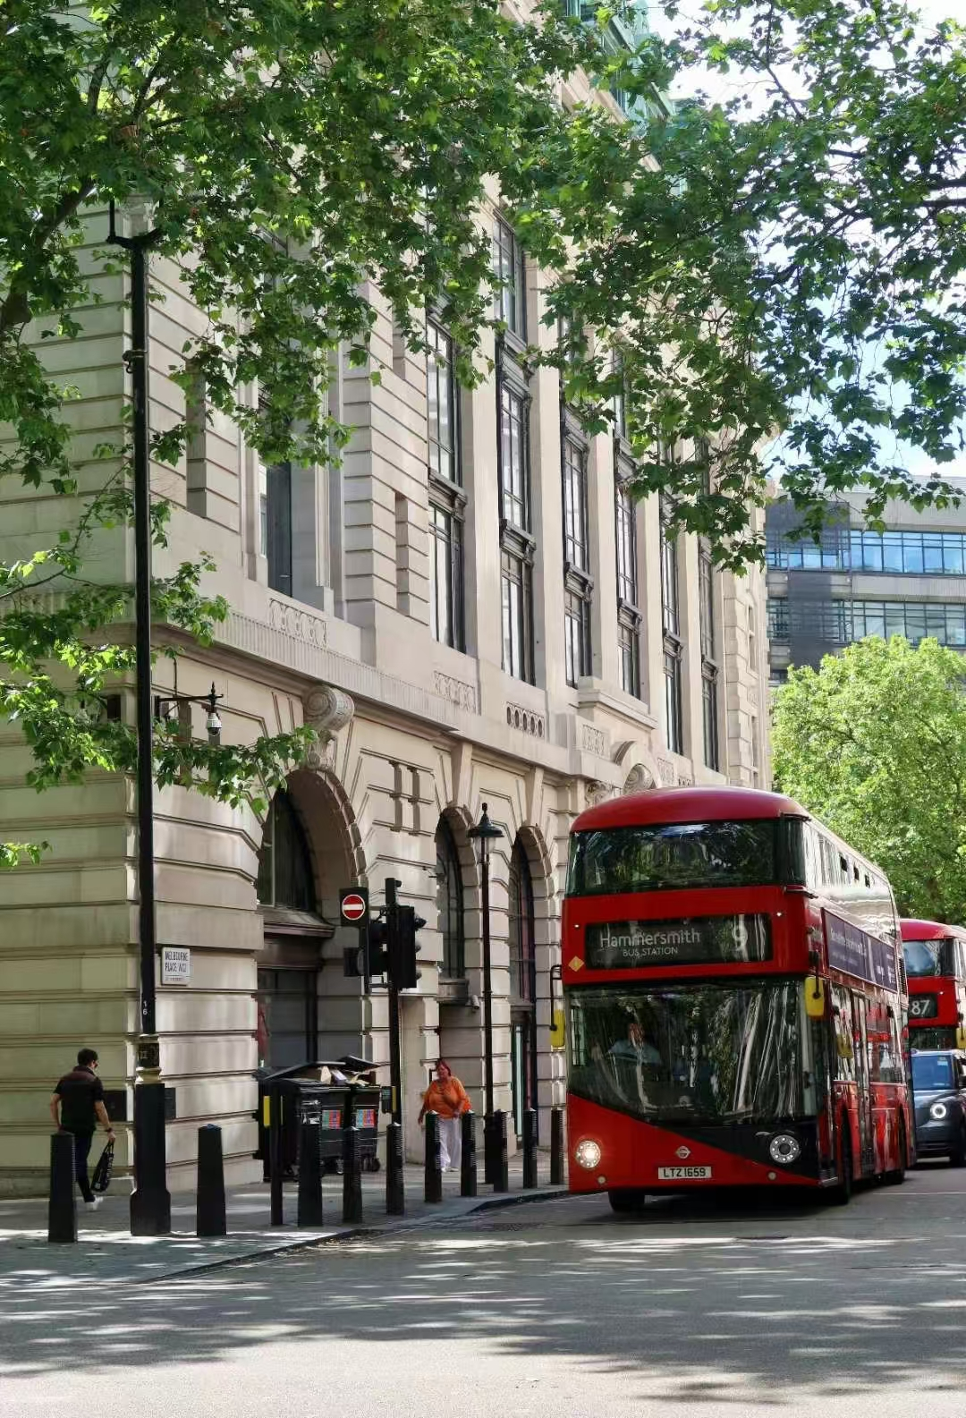
3.1 Living area & transportation & Food
Living Area: Sidney Web House (LSE Student Dormitory)
Transportation: Bus
Food: 早餐是包括在房费里面的
其他的需要自行解决，但LSE附近有非常多不错的吃的

Slide 13
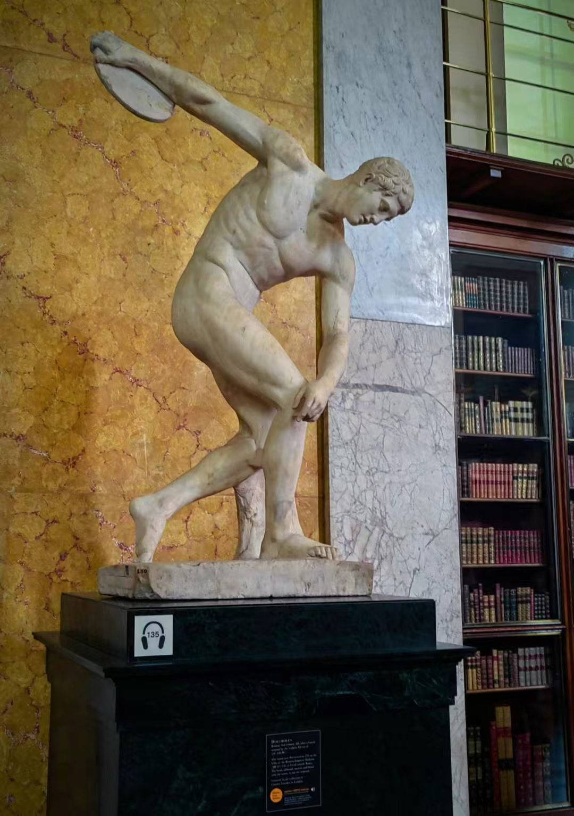
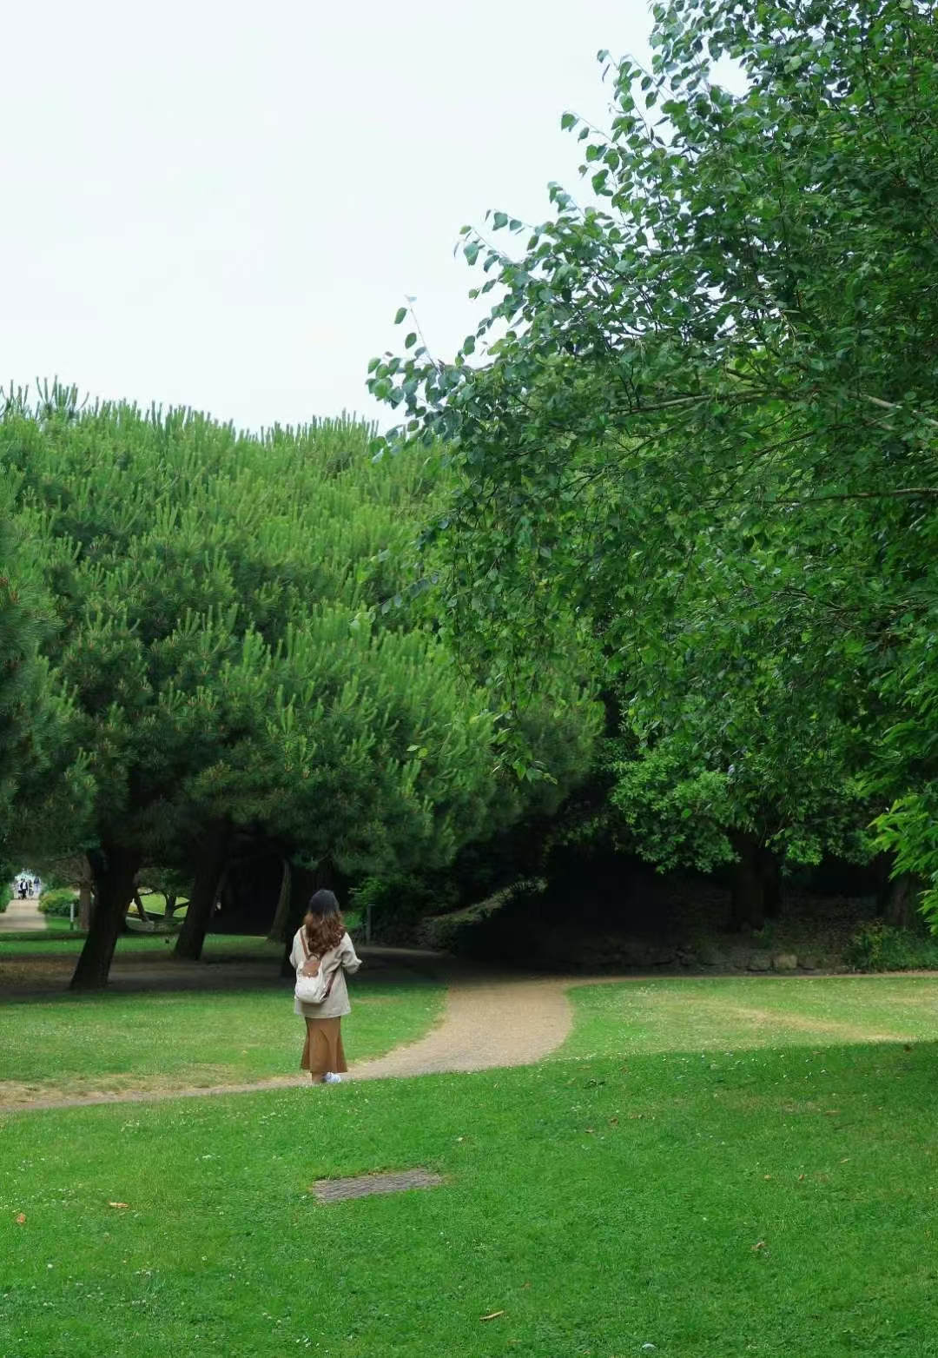
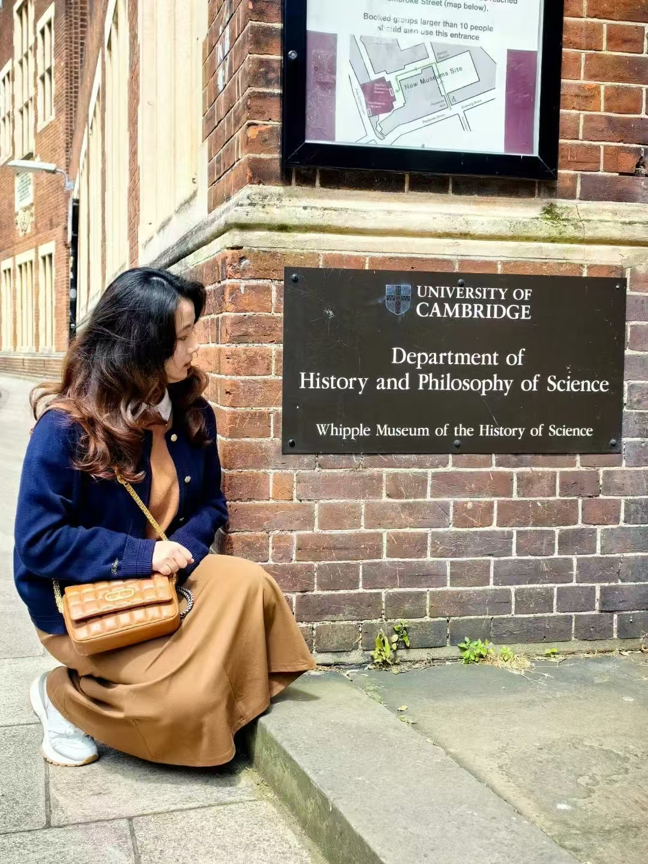
3.2 Entertainment

Slide 14
04
Feelings

Slide 15
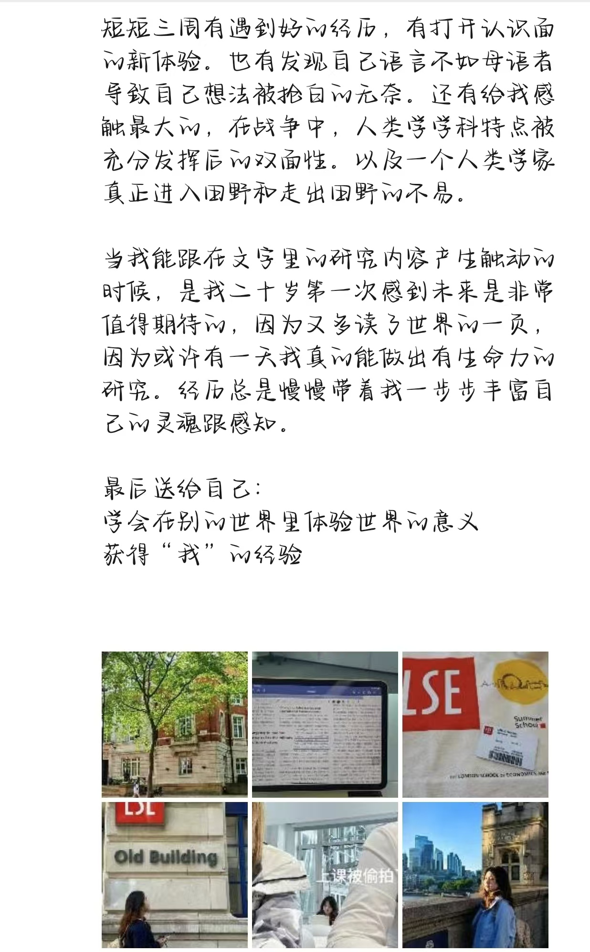
4.1 My feelings
New Journey to anthropology
Experienced competition with native speaker in seminars
Determined to learn social science in the future
学会在别的世界里体验世界的意义，获得“我”的经验

Slide 16
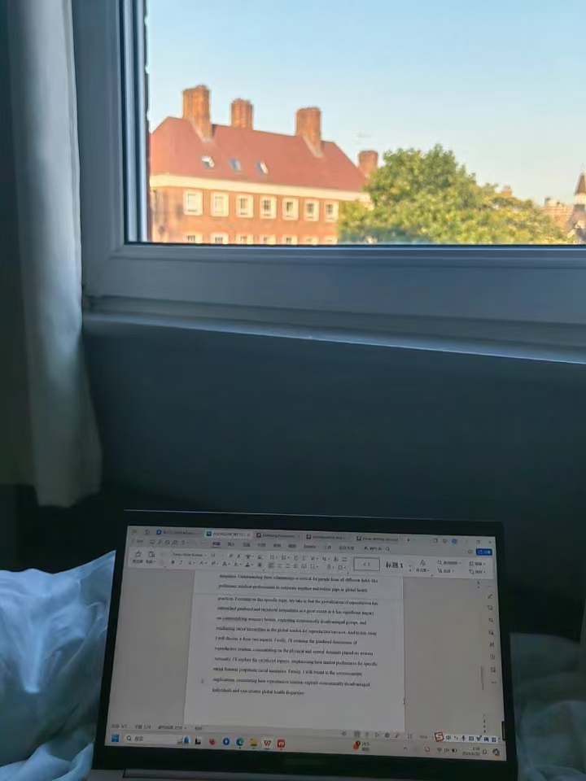
4.2 Future Study Advice
想要过一个轻松一点的硕士的：
No LSE
Have passion for academic: consider it
But be prepared for high competition with white native speakers (Learn English Well)

Slide 17
Thank you for listening

