Slide 1




2024 Girton Program S haring
2024 剑桥格顿学院
暑期交换项目经验分享
presenter: Lydia
23DGS金子灿

Slide 2
Table of contents
01.
02.
03.
Course description
课程学习介绍
Life experience
衣食住行
Personal feeling
个人感受

Slide 3

01.
Course description
课程学习介绍

Slide 4
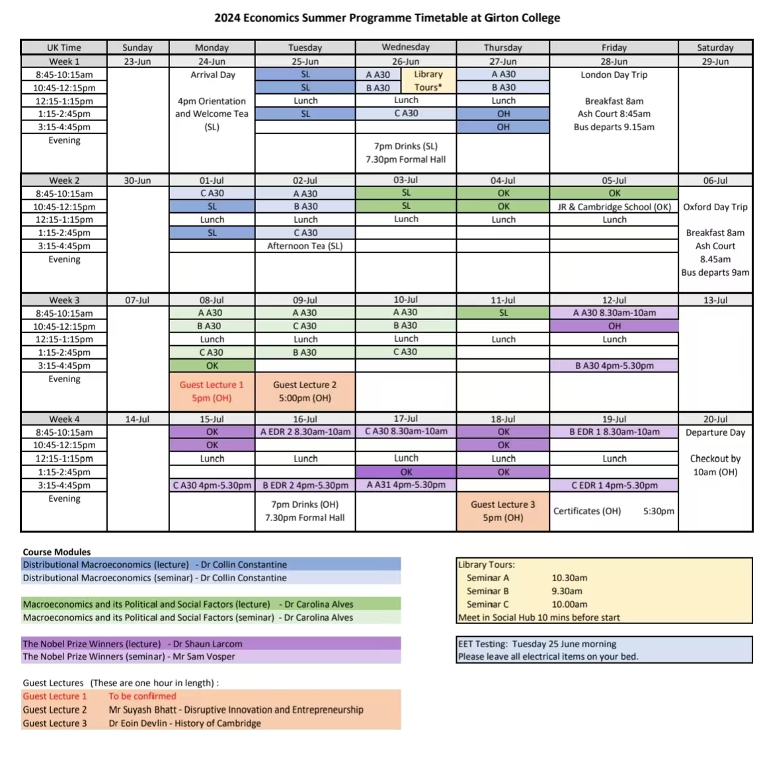
Curriculum structure课程结构
Major：economics
Course：2h/节
1.Distributed Macroeconomics
宏观经济学
2.Macroeconomics and its Political and social factors
宏观经济学及其政治社会因素
3.The Nobel Prize Winners
诺贝尔奖得主
2 essays➕4 presentations

Slide 5
Course description
1.Summer program is easy and just for fun.
暑期项目很简单，就是去玩的。。。
2.Only apply for summer programs related to your major.
暑期项目只能报自己专业相关的。
3.I couldn't understand the teacher when I was in the summer program.
我参加暑期项目听不懂老师讲课
English
Welsh
Scottish Gaelic
Scots
Cornish
Irish
Ulster Scot

Slide 6
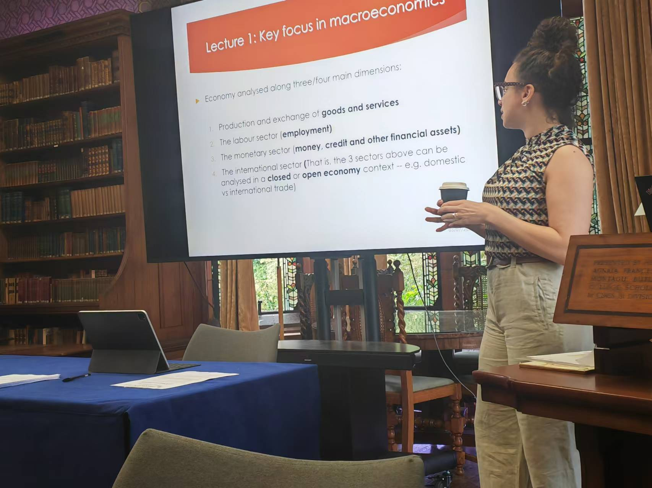
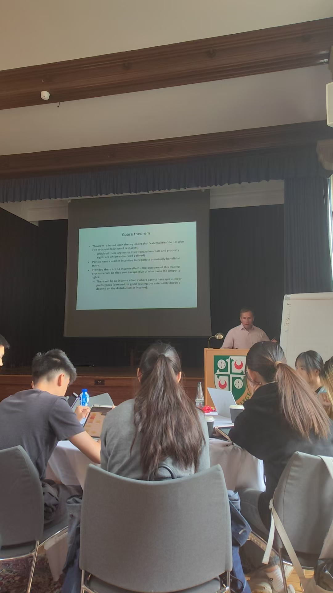
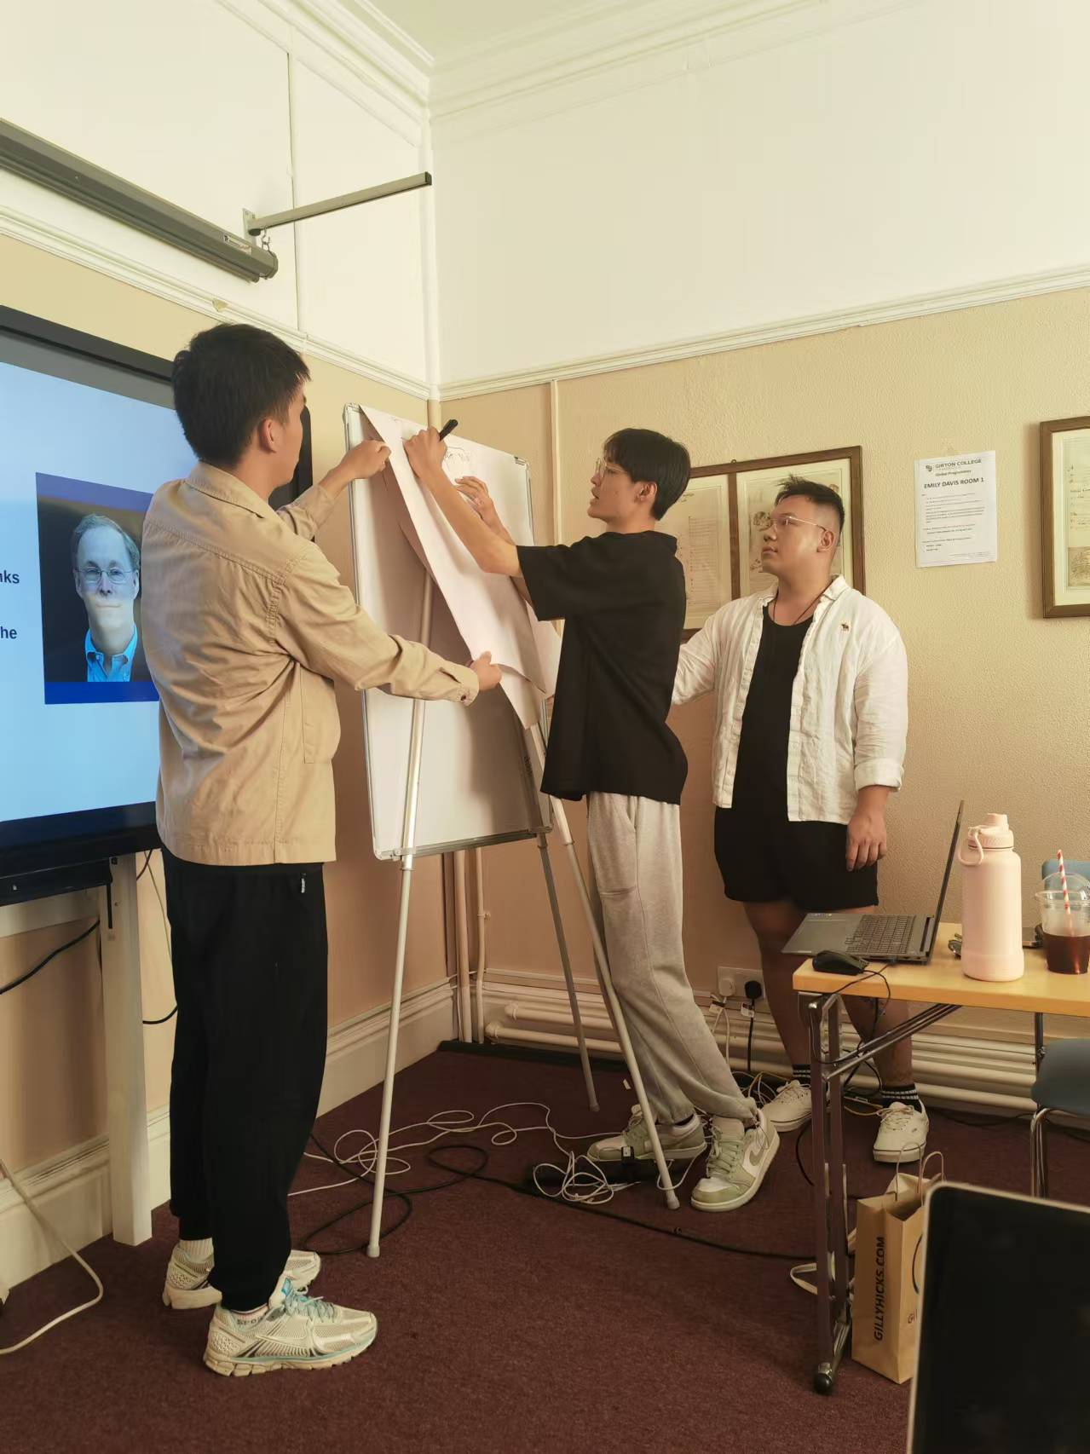

Slide 7

02.
Life experience
衣食住行

Slide 8
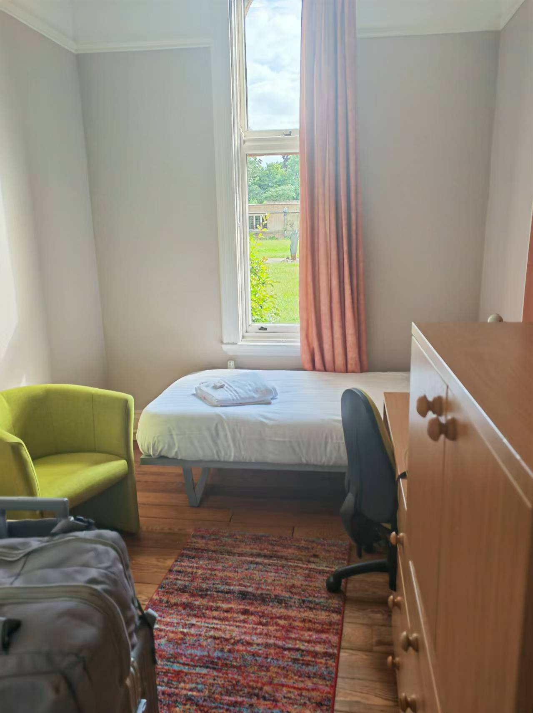
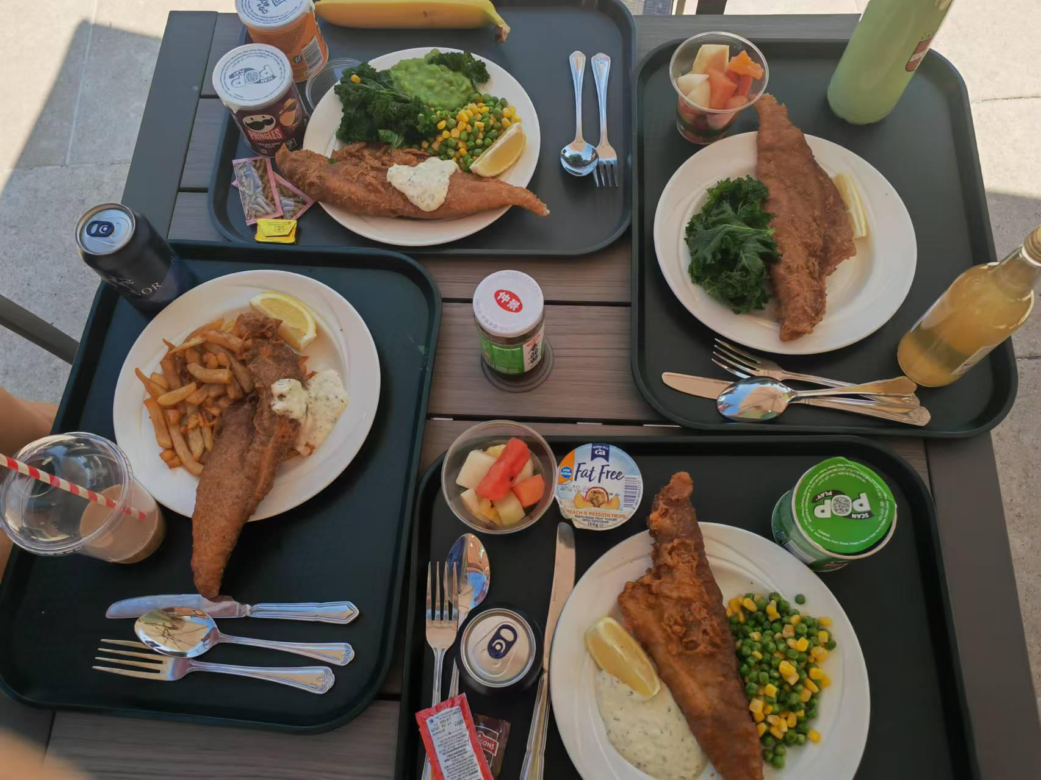
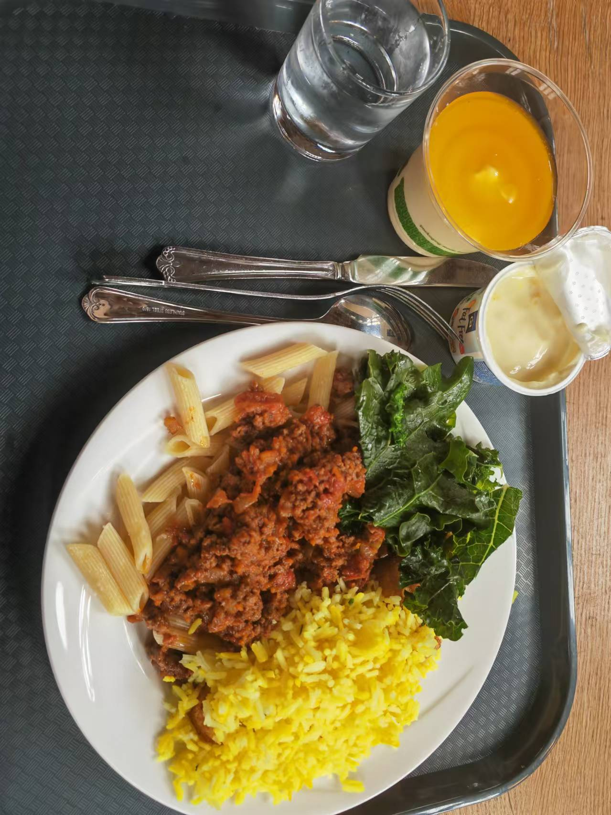
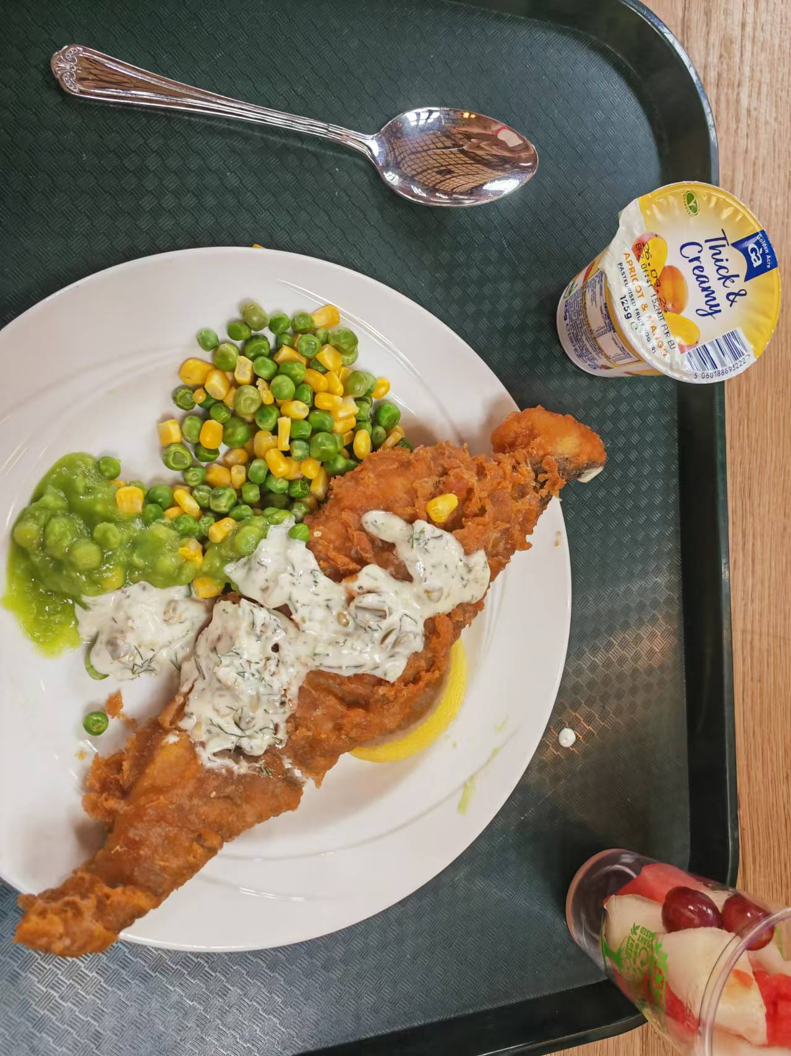
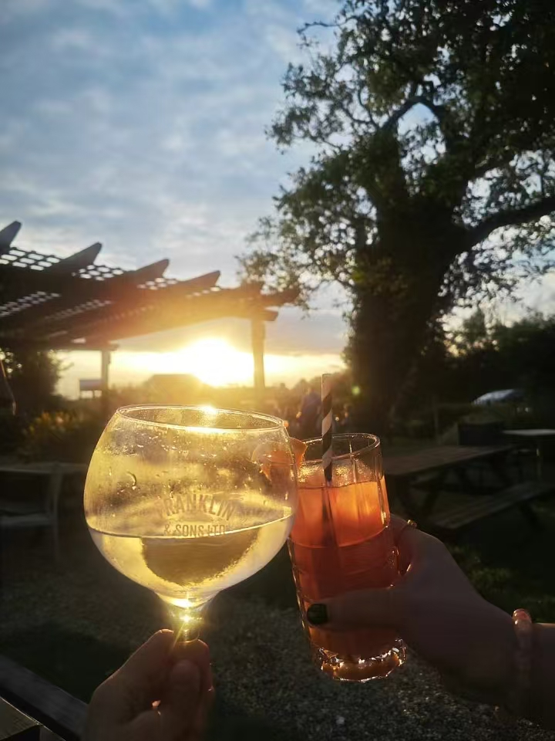
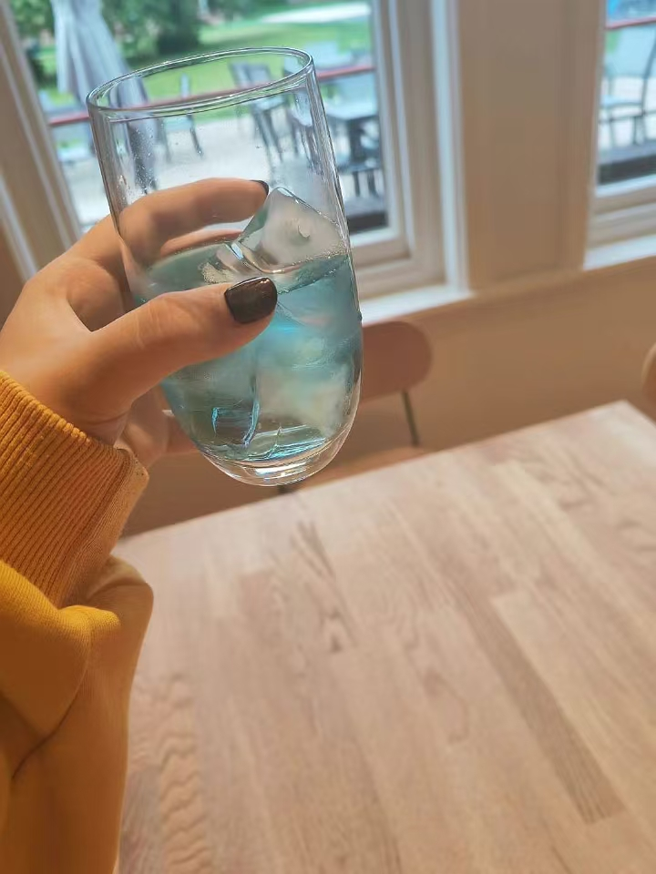
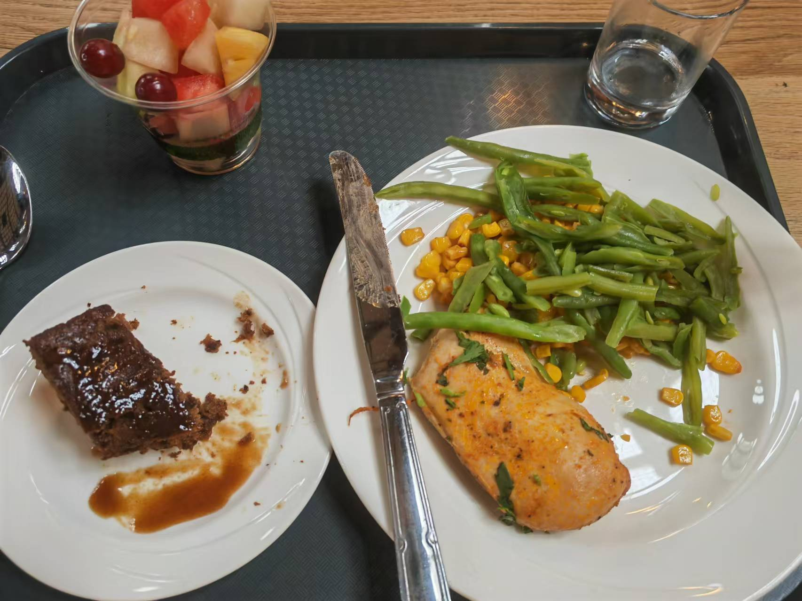
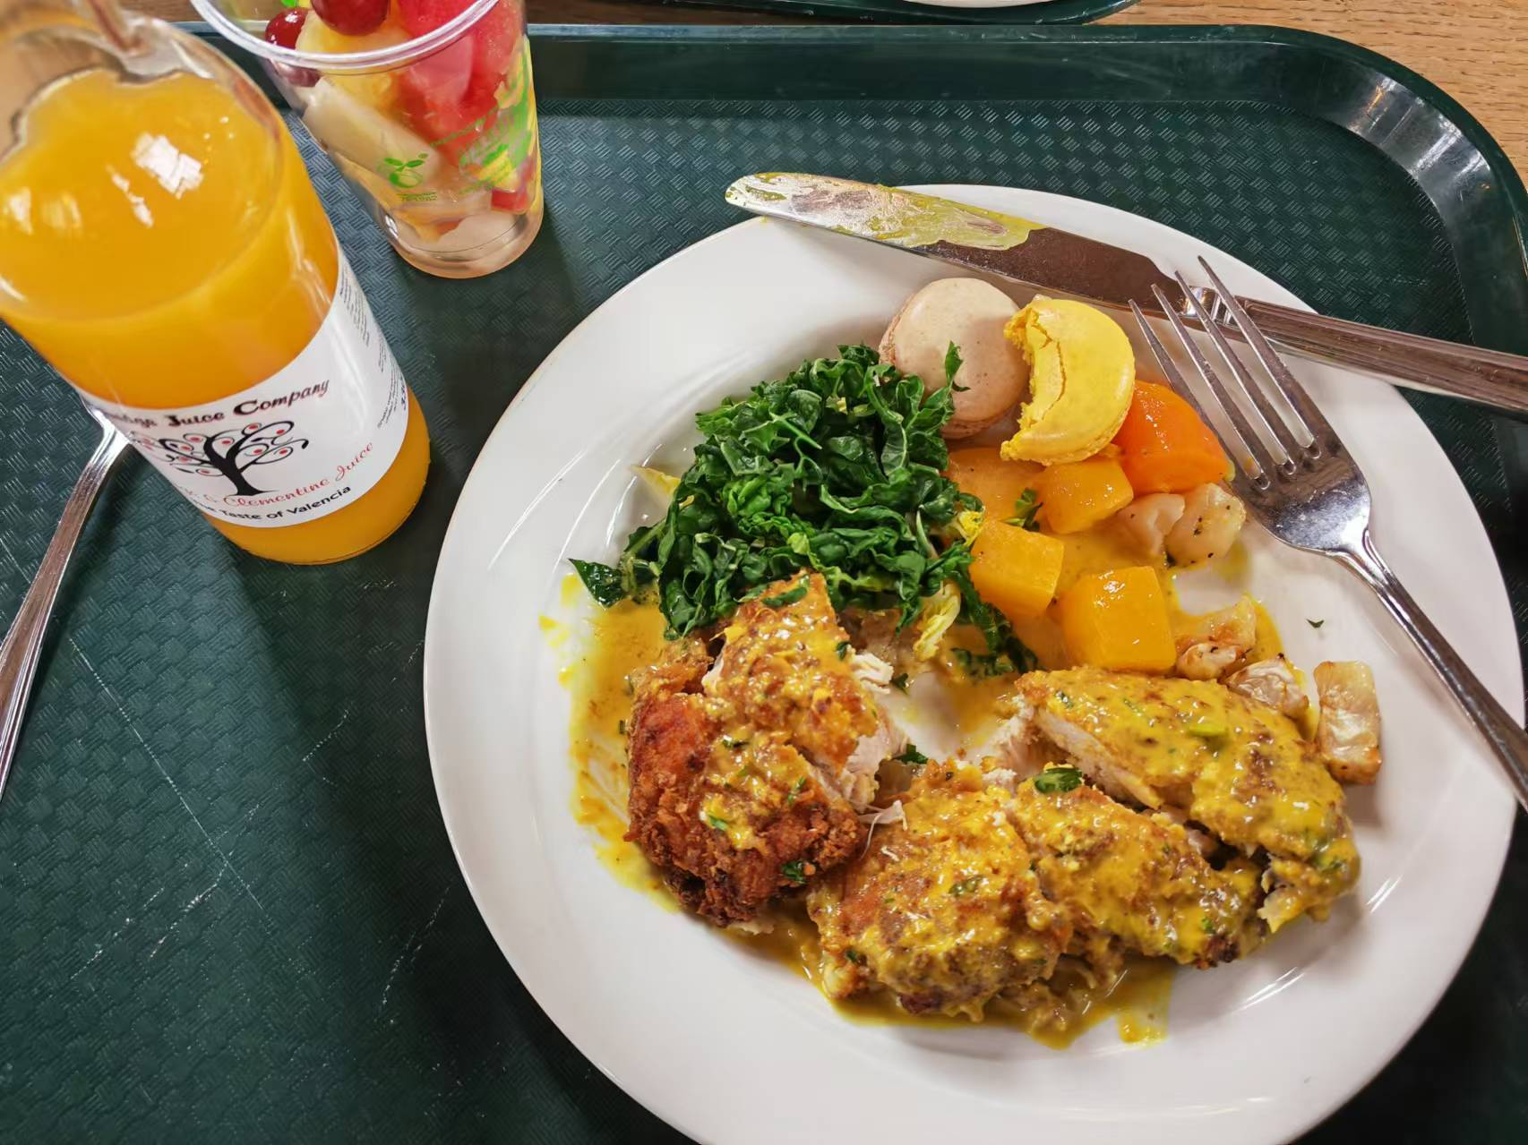
School activity arrangement 学校安排
1.Food吃饭

Slide 9
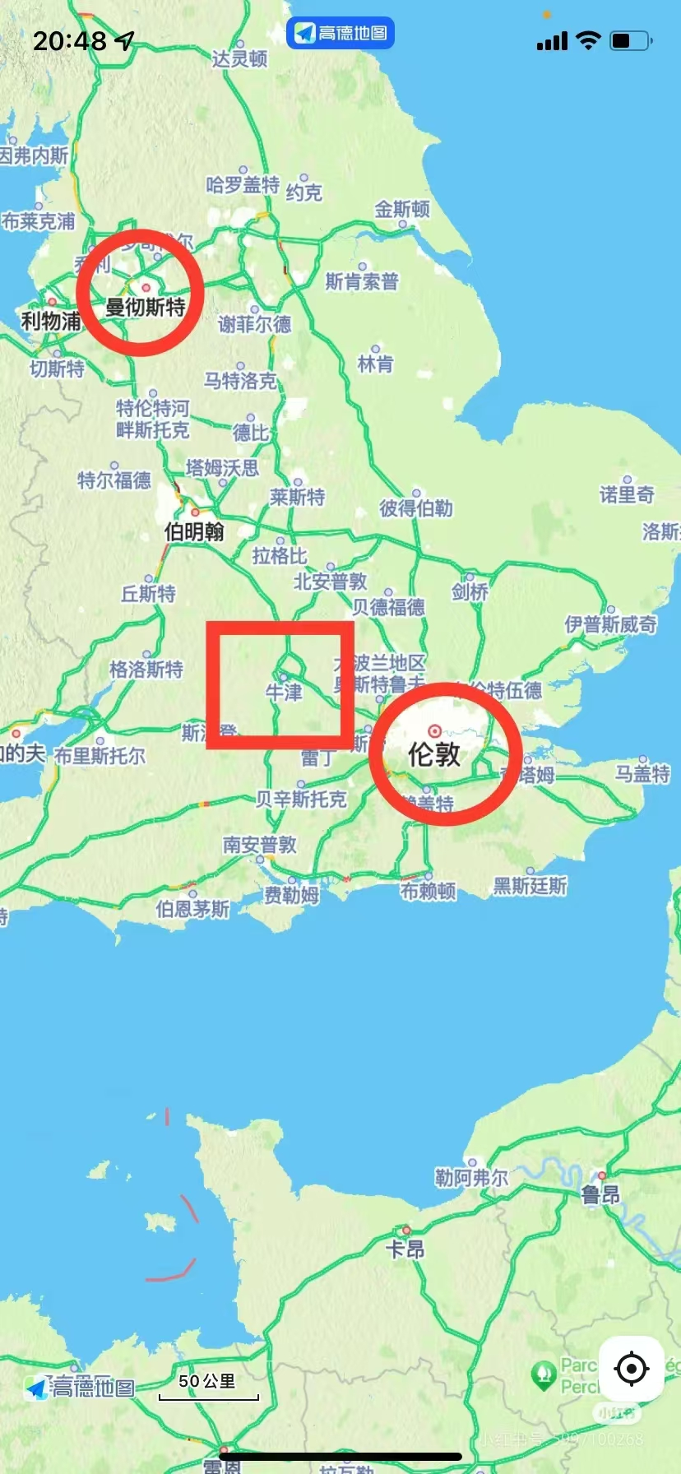
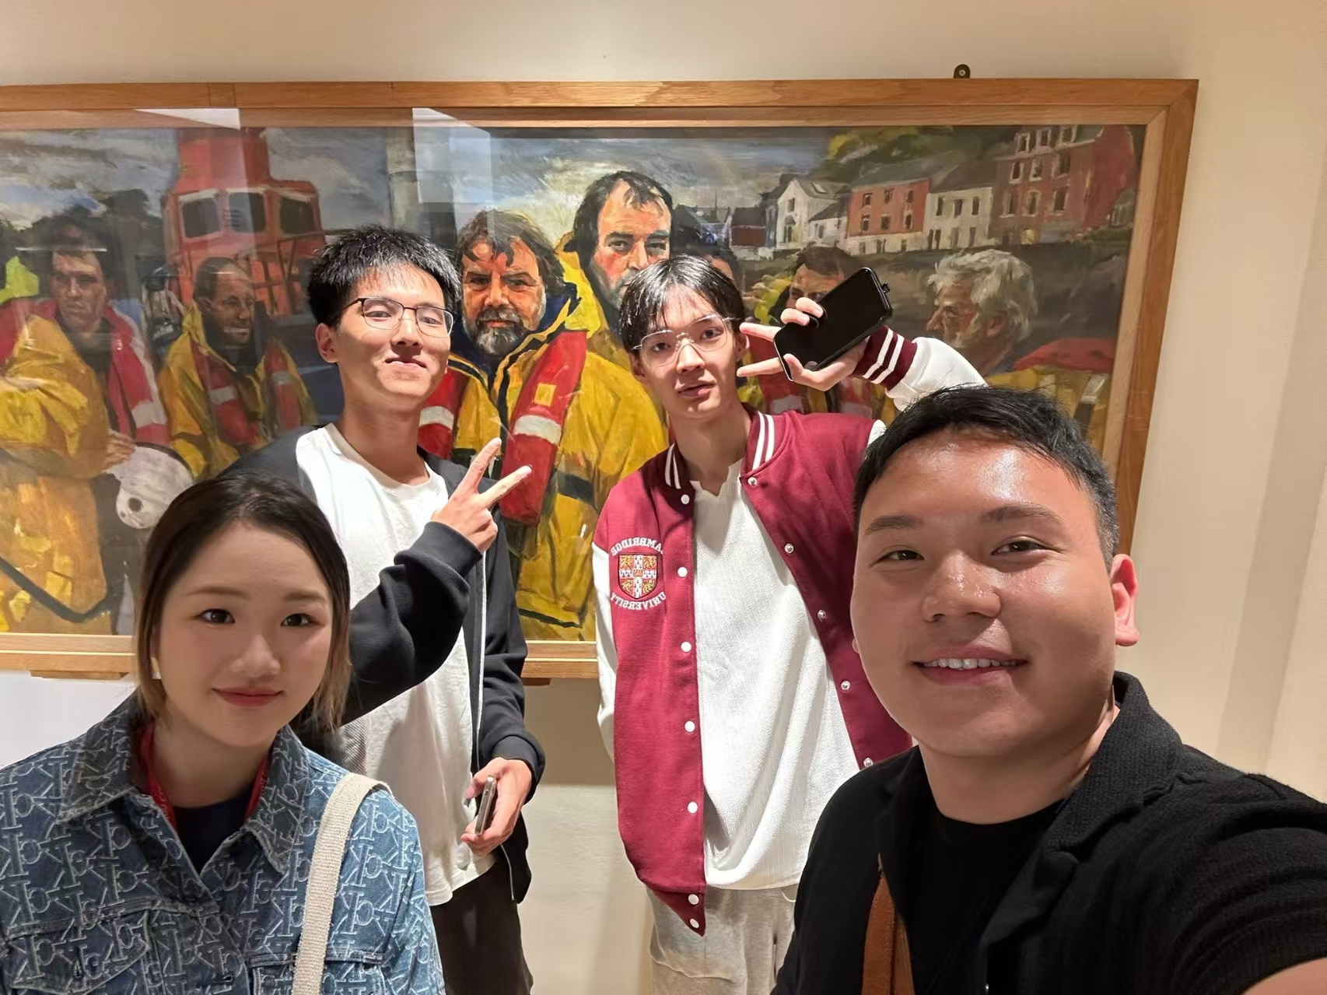
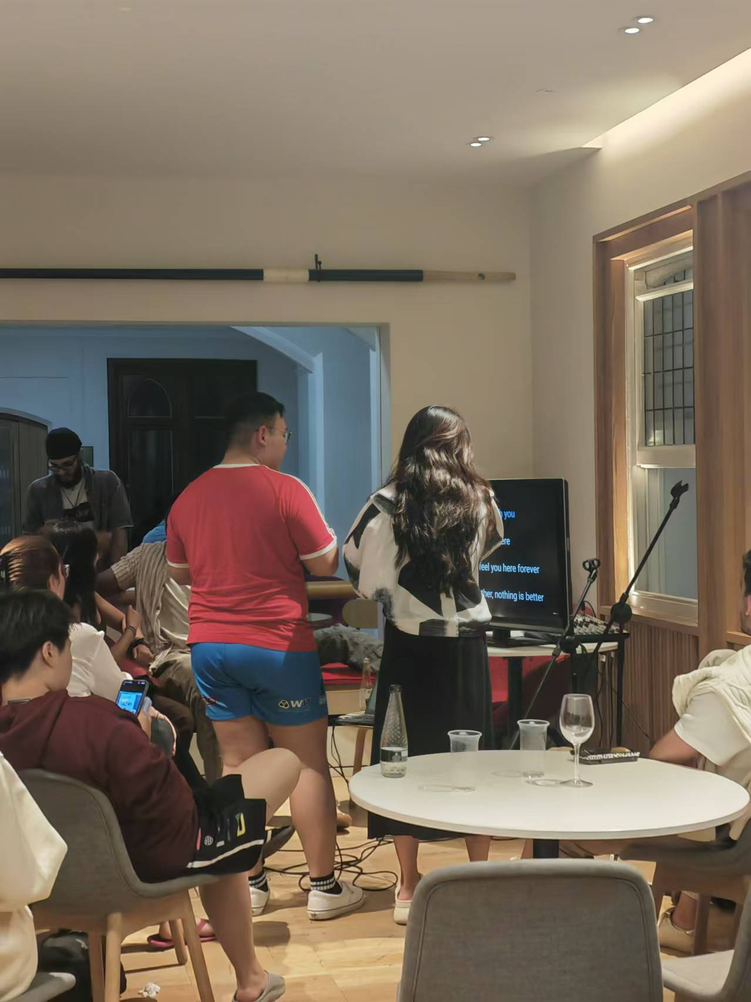
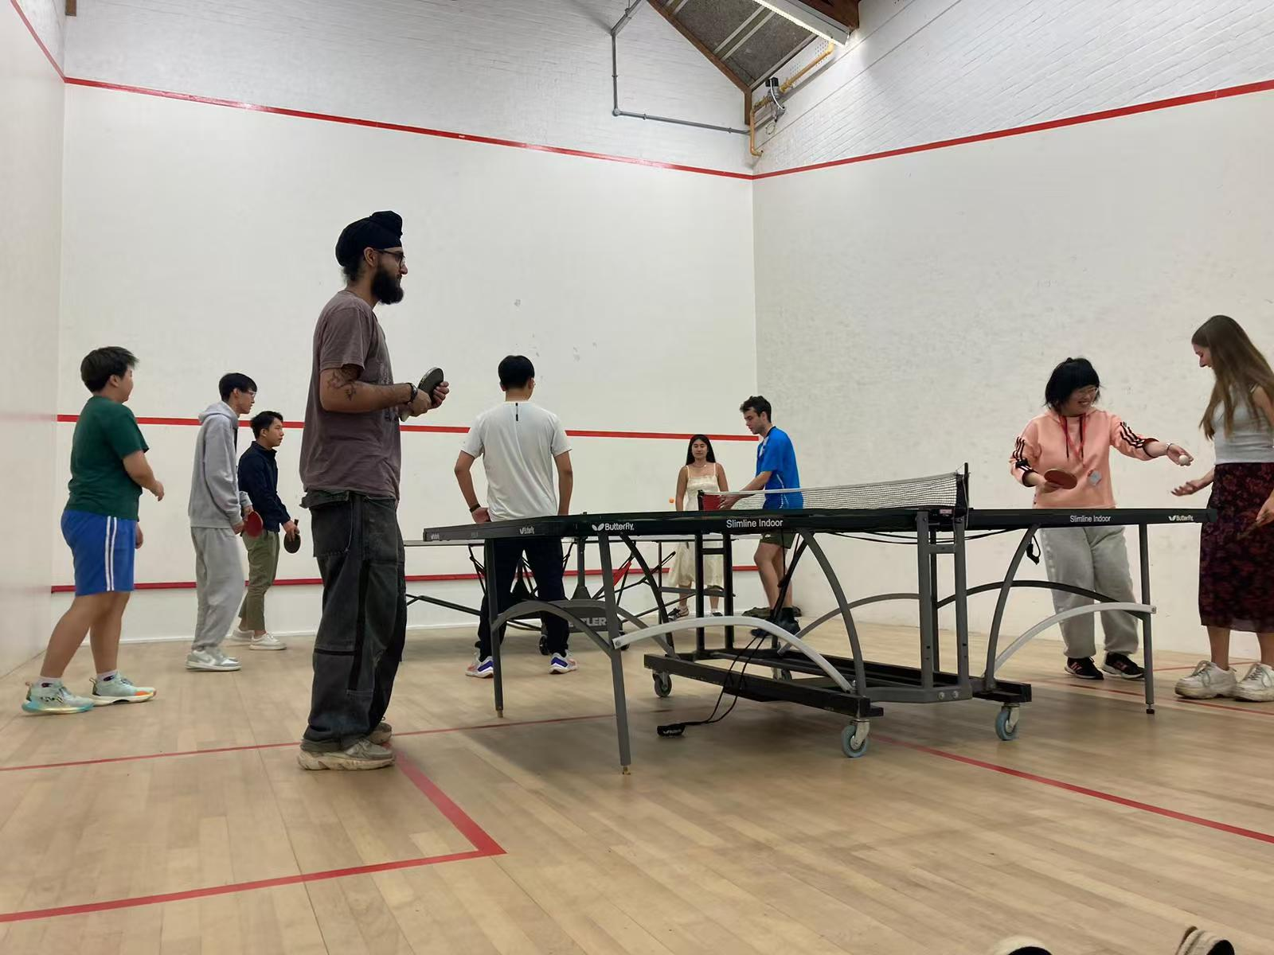
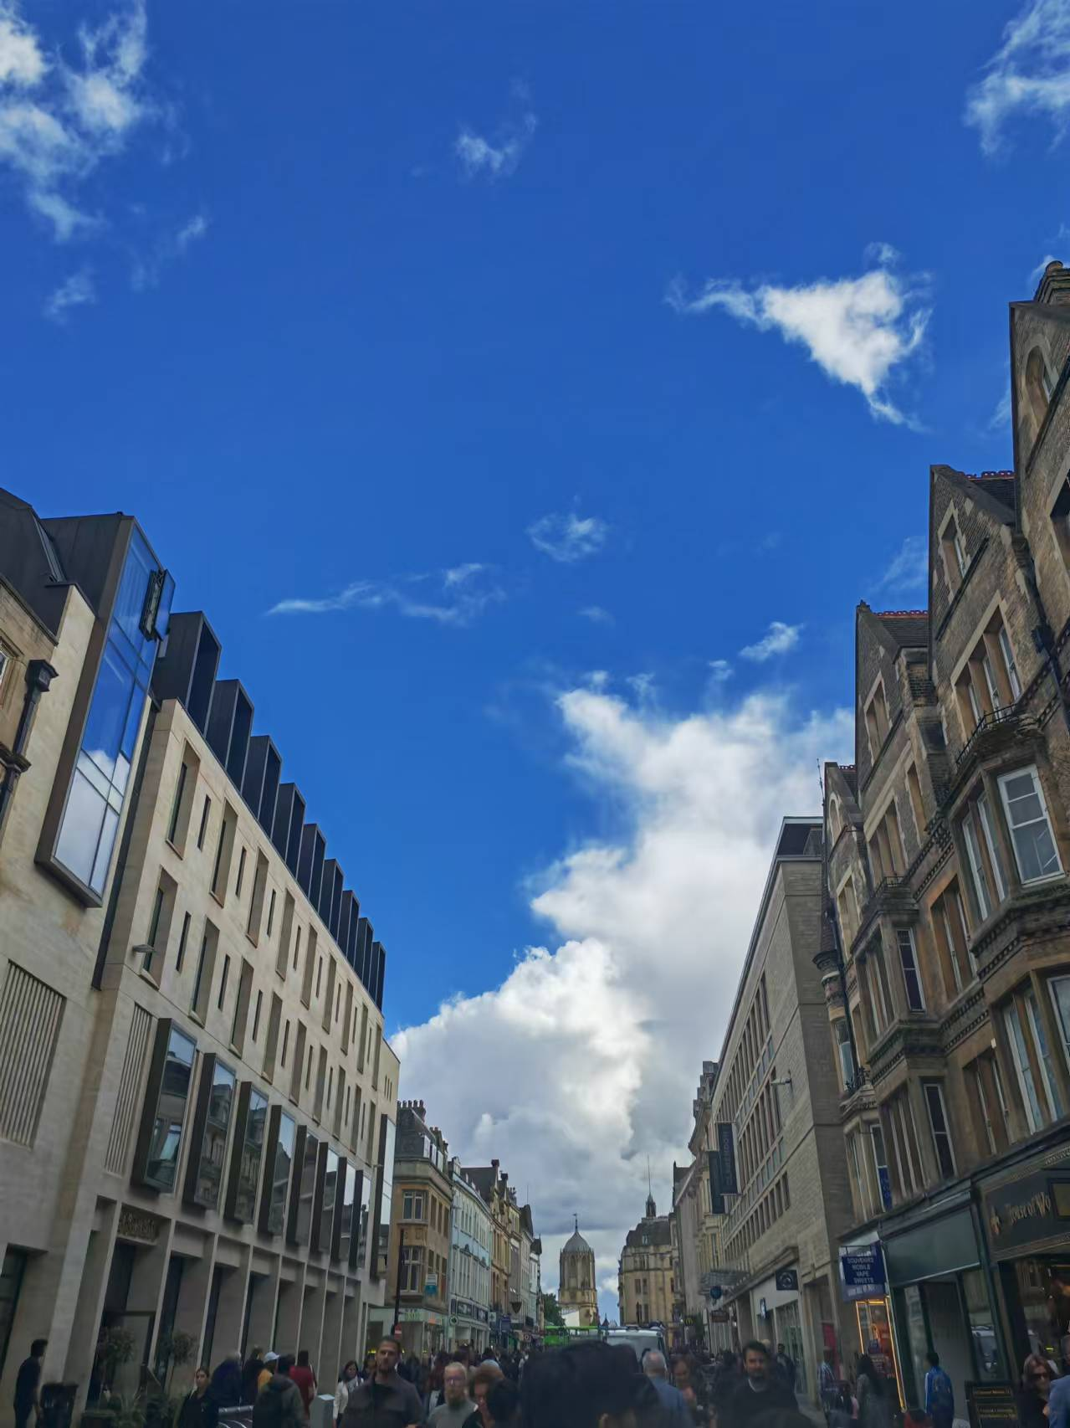
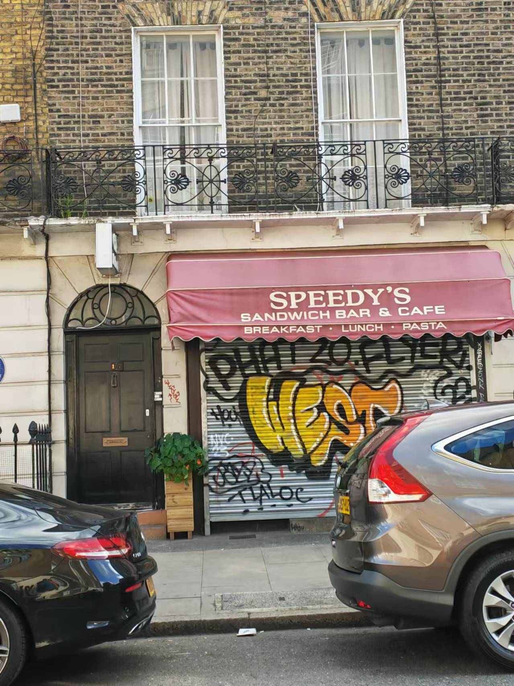
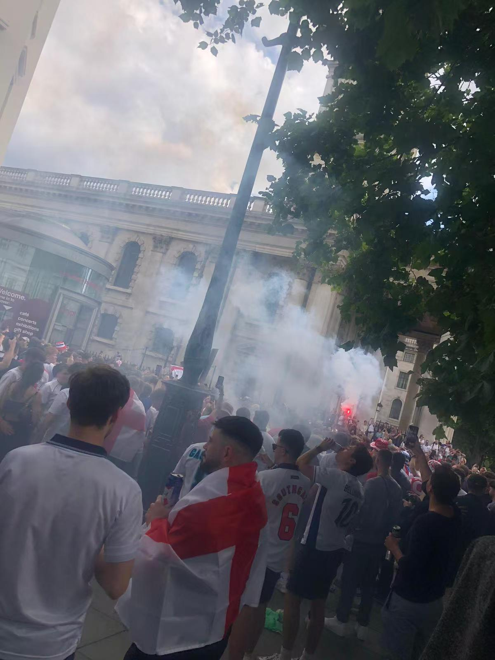
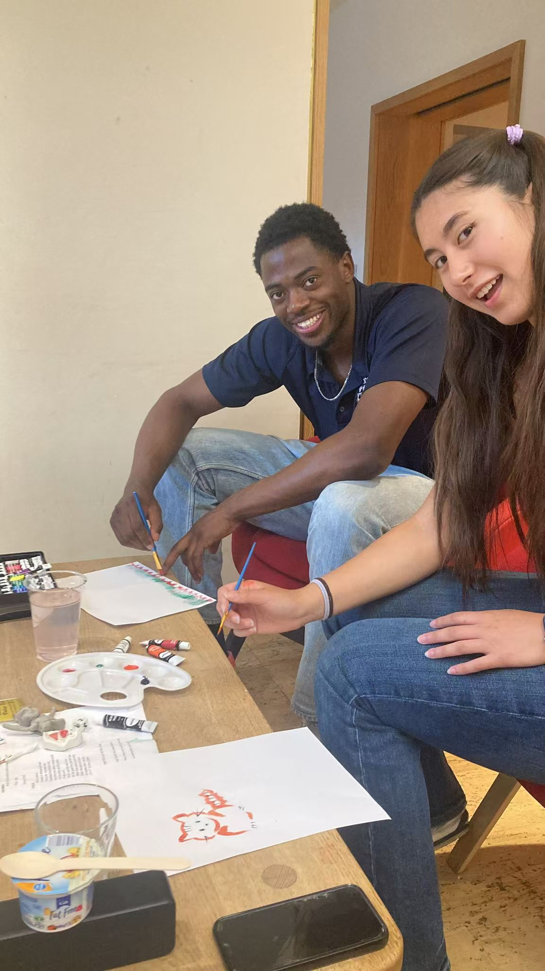
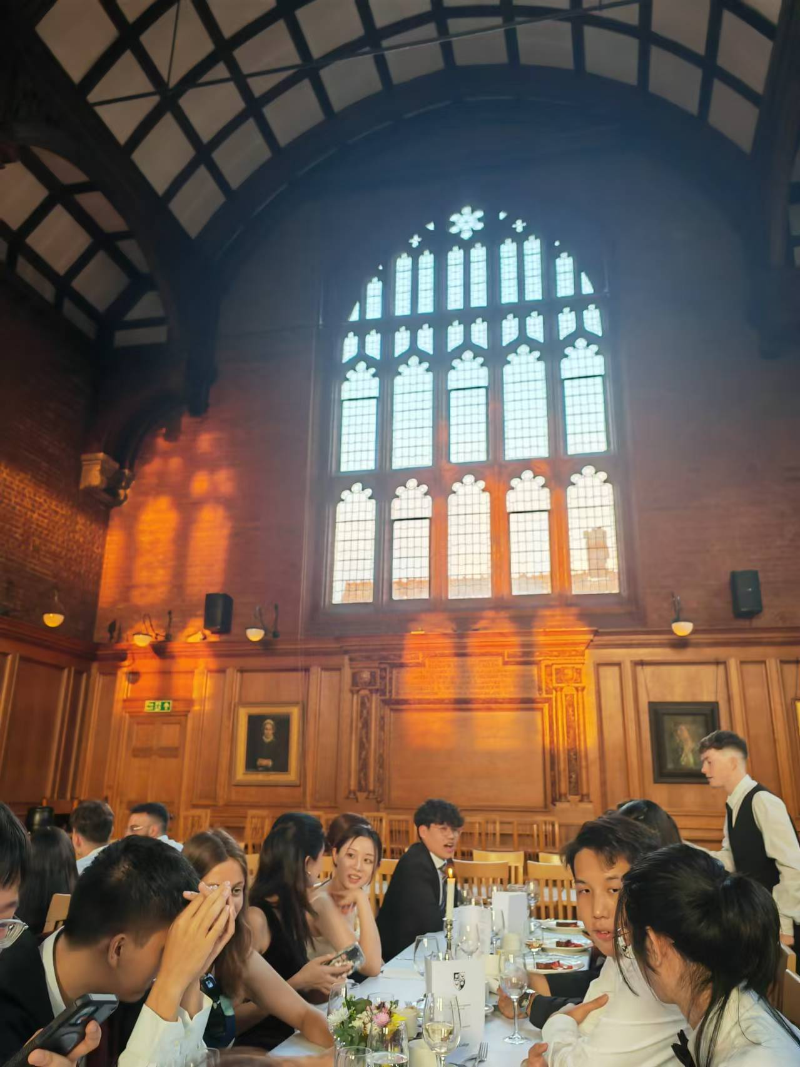
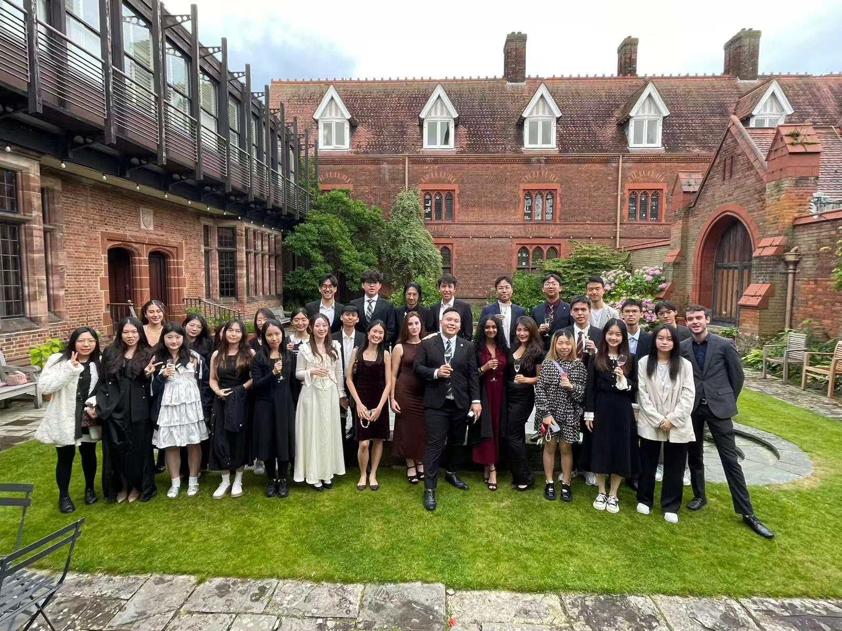
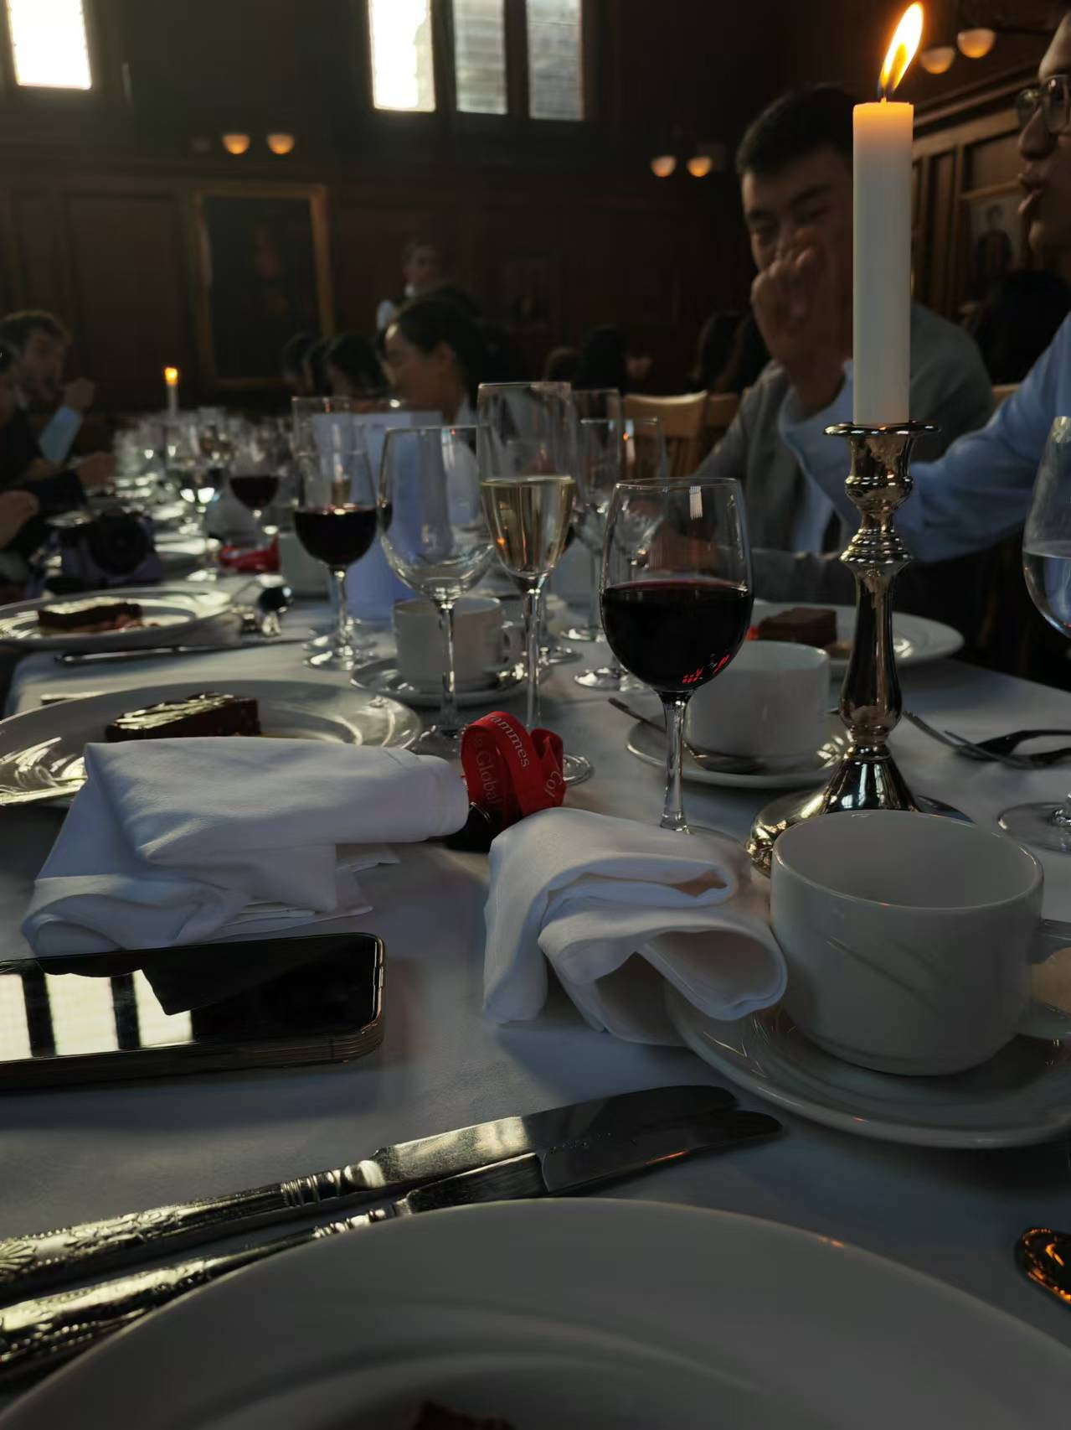
School arrangement 学校安排
2. Extracurricular Activities 课外活动
（1）London Trip伦敦之行
（2）Oxford Trip 牛津市游学
（3）High Table Dinner 前后两次高桌晚宴
（4）KTV
（5）sports activities（squash，pingpong...）运动项目

Slide 10
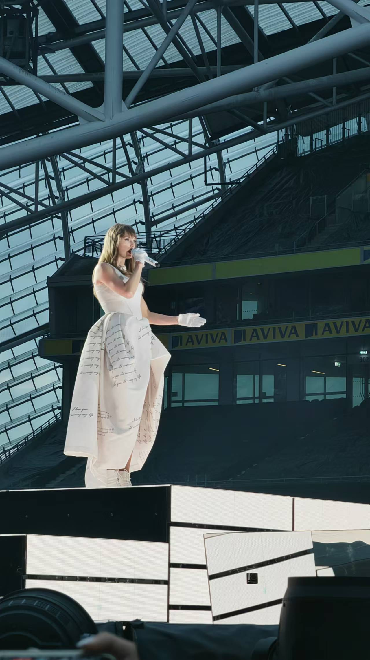
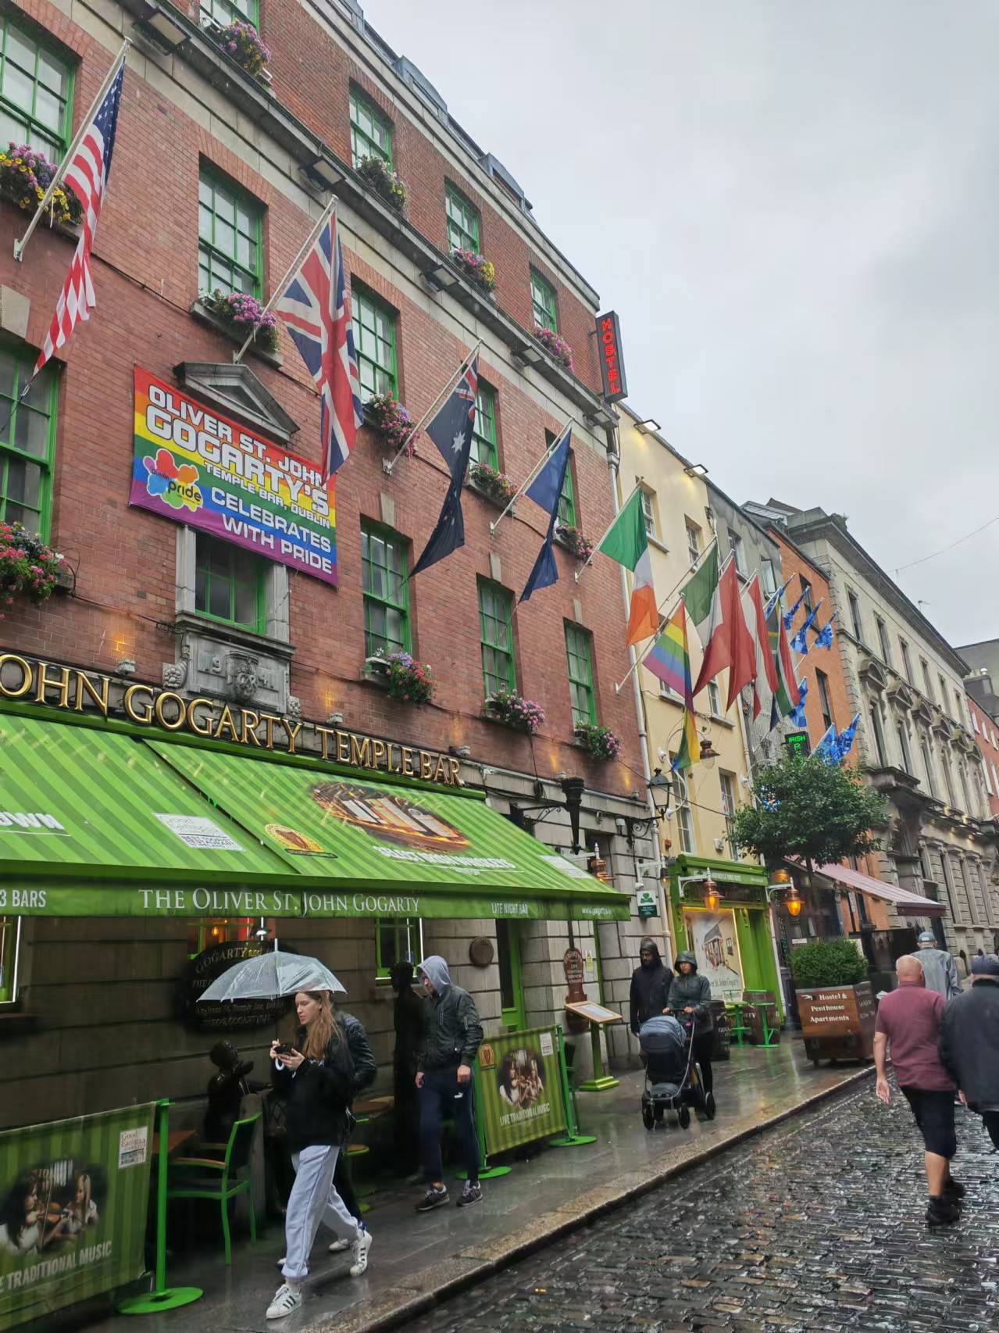
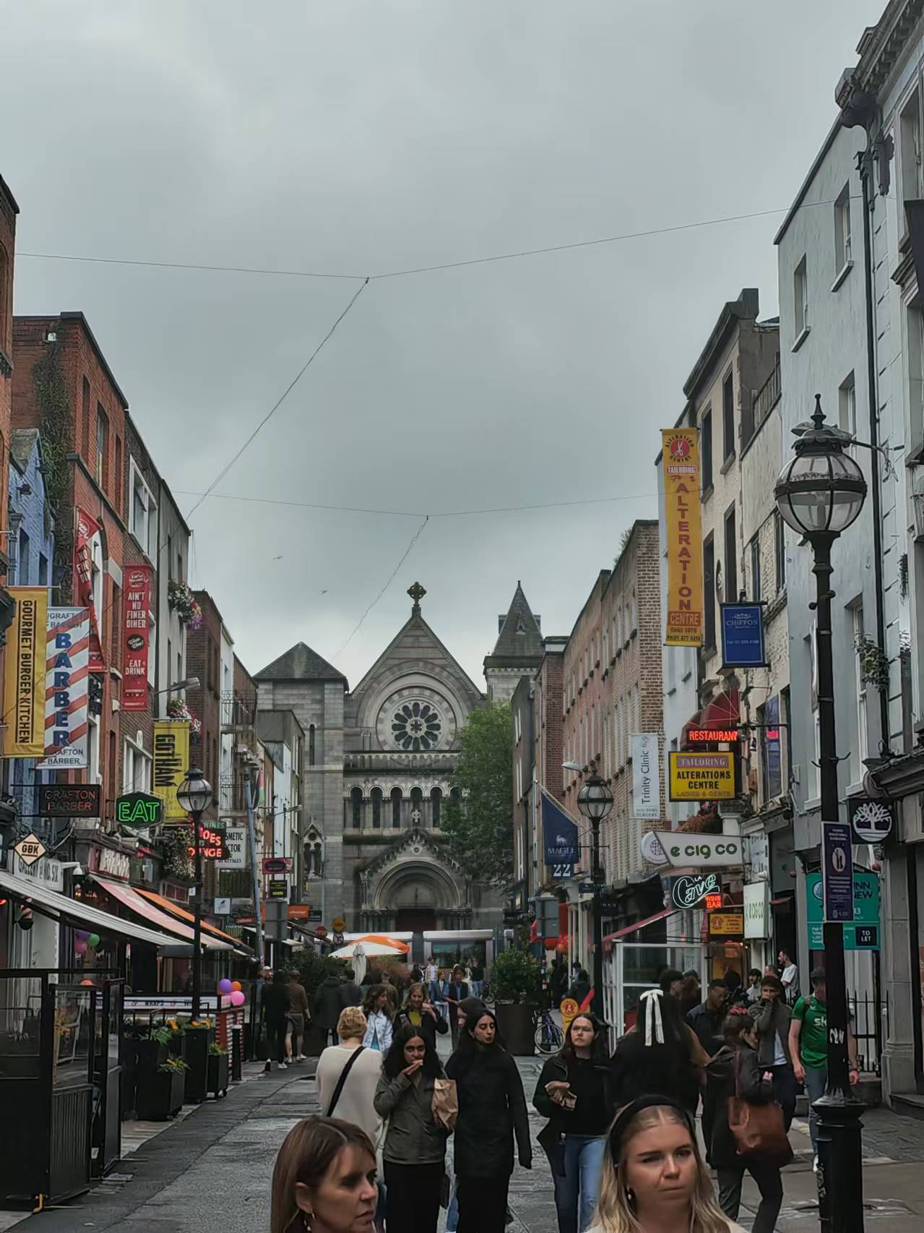

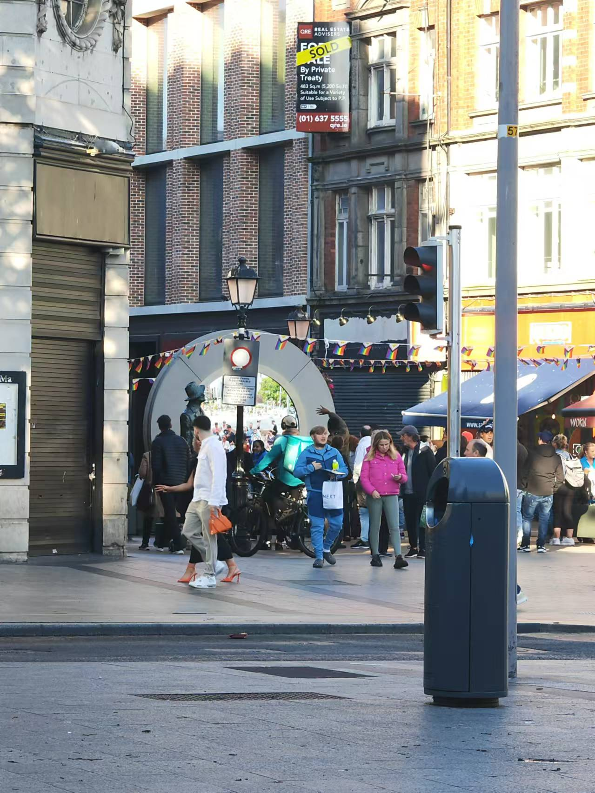
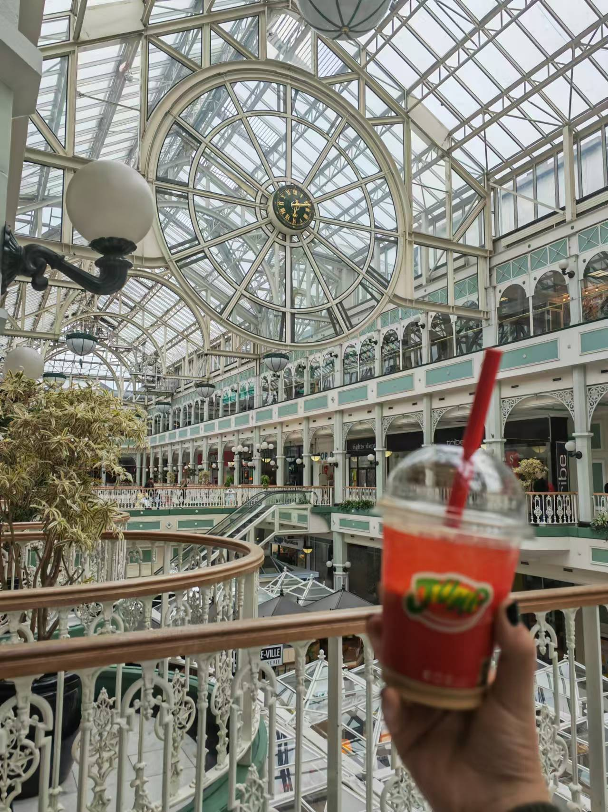
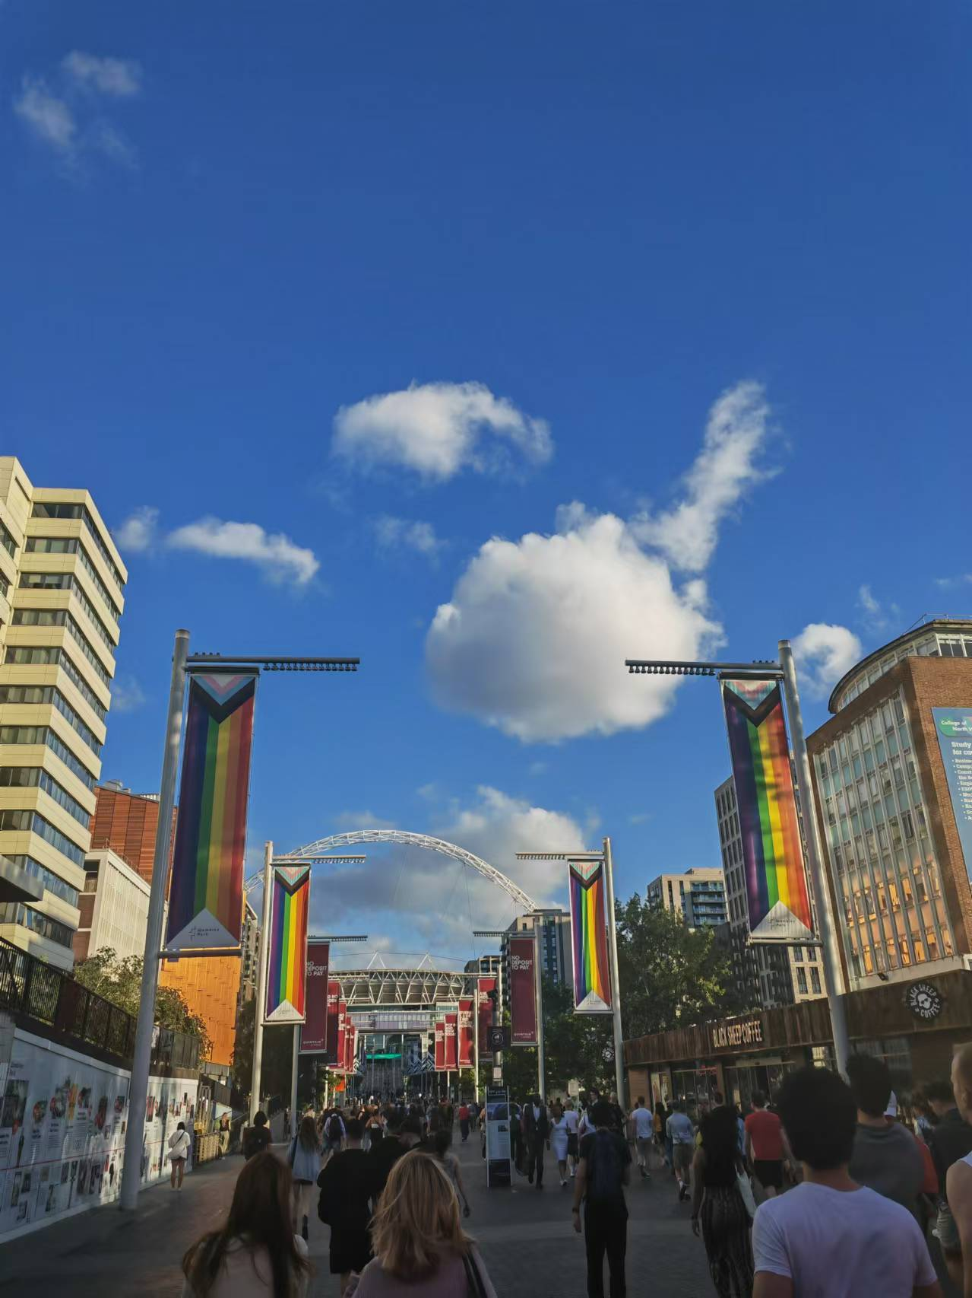
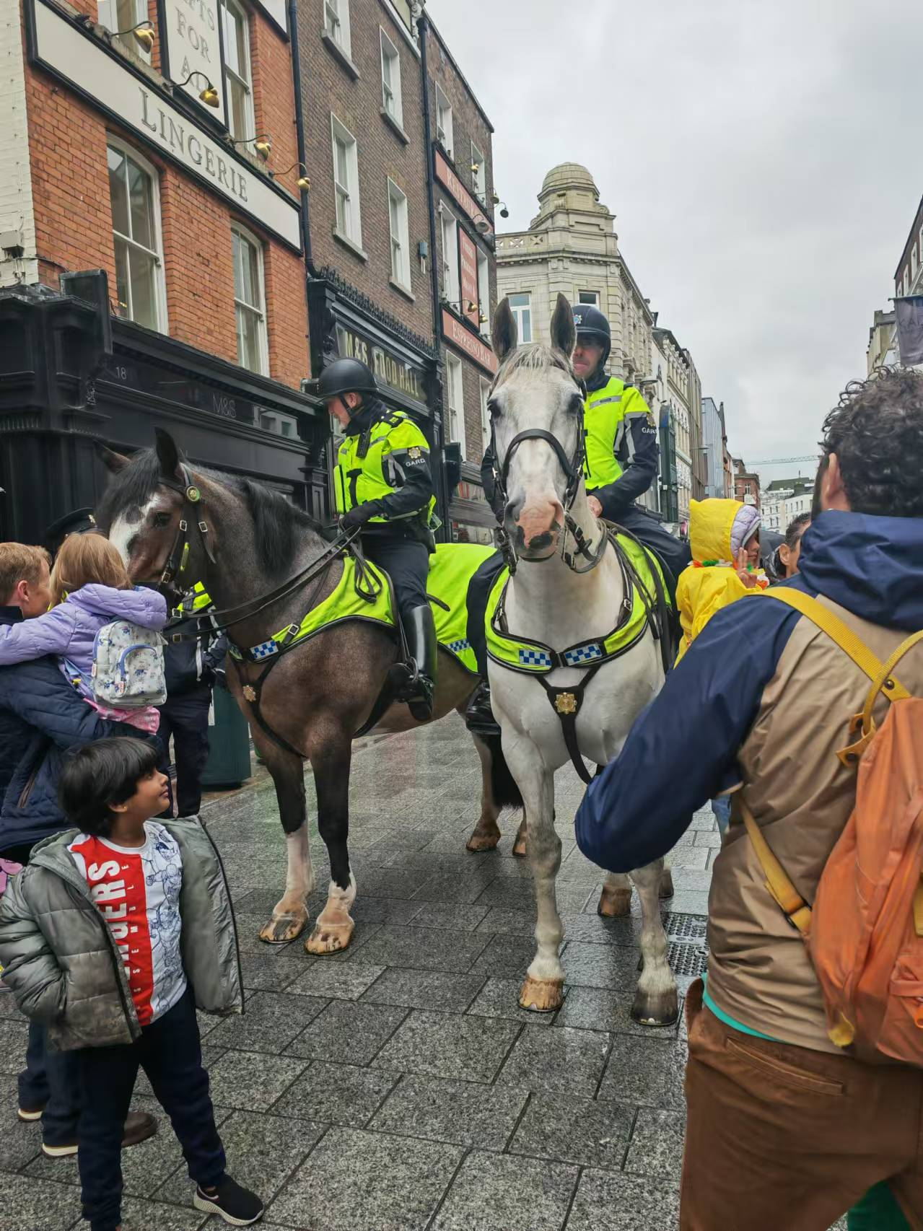
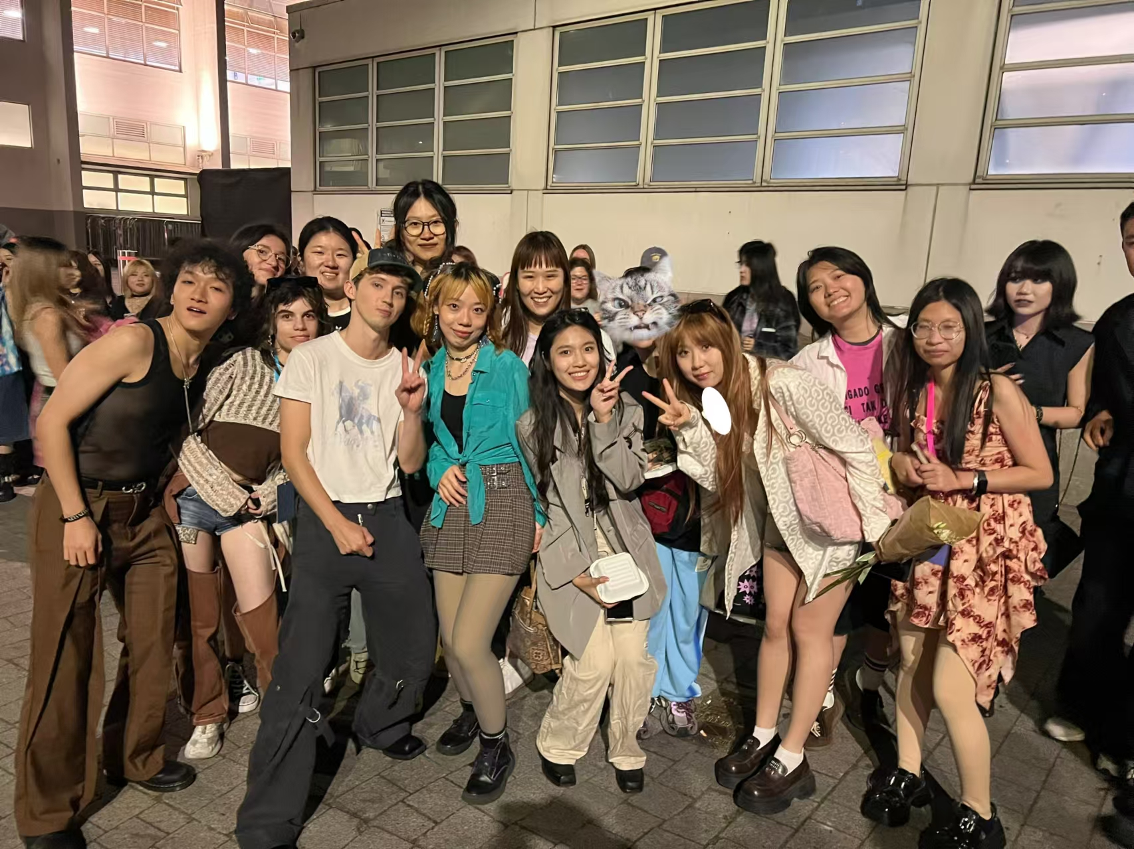
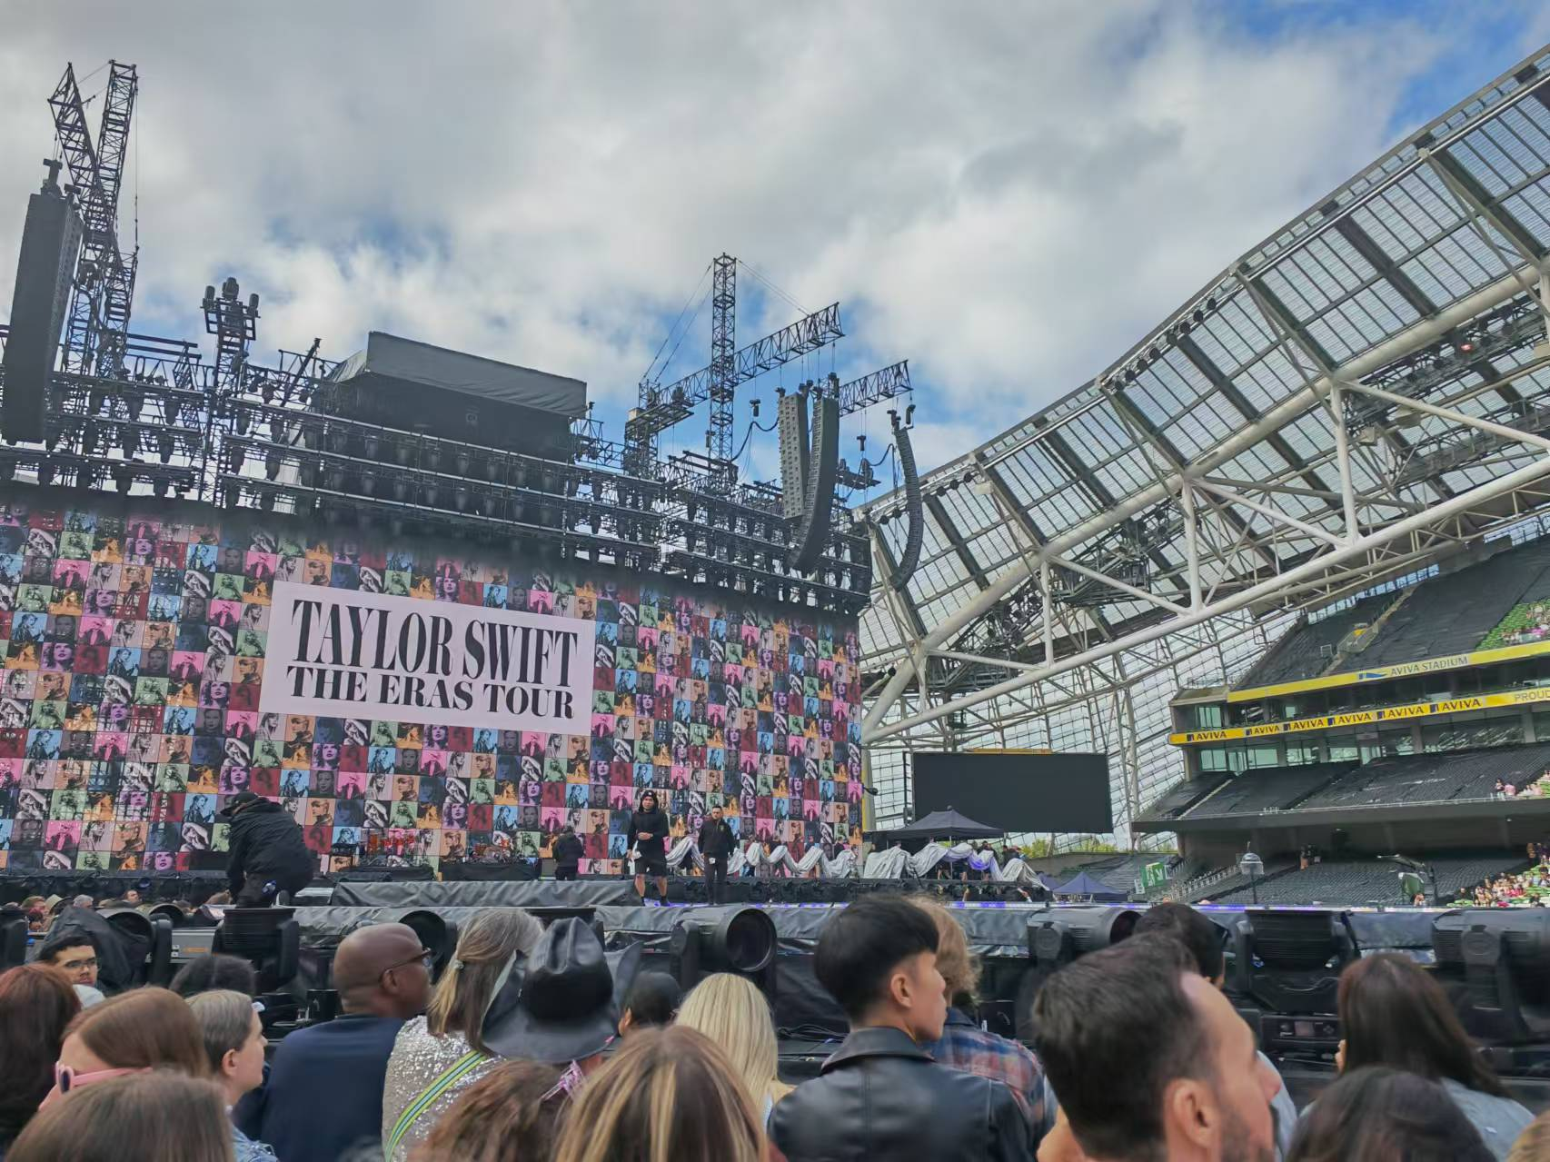
Personal arrangements 个人安排
1.A trip to Ireland and a concert
爱尔兰之行和演唱会

Slide 11

03
Personnal feelings
个人感受

Slide 12
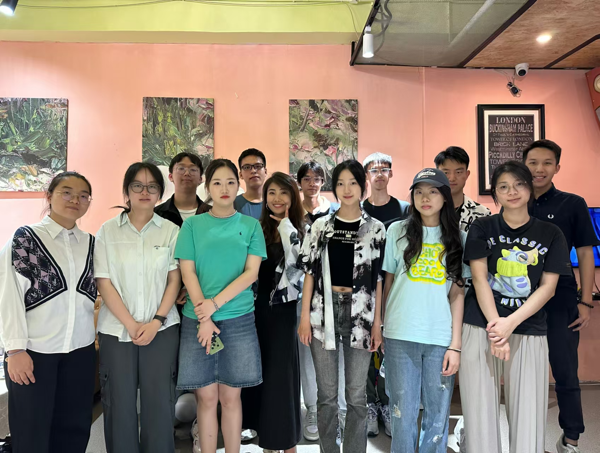


Personal feelings 个人感受
interpersonal relationship
language competence
preparation for studying abroad
learning motivation
人际关系
语言能力
学习激励
留学申请

Slide 13


Thank you for your listening

