Slide 1

Experience & Comments
in ESADE
Do good. Do better.
汇报人：2020级 ACCT 杜奕娇

Slide 2

CONTENTS
1
Why Esade
2
Summer Courses
3
Funny Experience
4
All The Regrets

Slide 3
PART 01
Why Esade
Do good. Do better.

Slide 4

Why Esade?
01
02
03
巴塞罗那
网课优惠
留学体验

Slide 5
PART 02
Summer Courses
Do good. Do better.

Slide 6
Summer Courses
International Business
International Finance
International Marketing Strategies

Slide 7
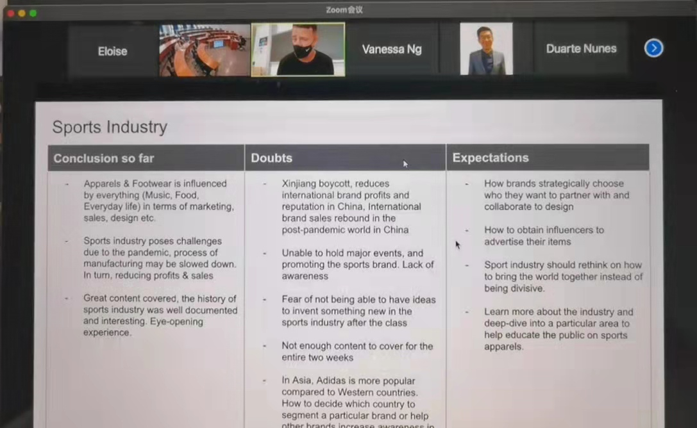

Summer Courses
Sports Management

Slide 8
PART 03
Funny Experience
Do good. Do better.

Slide 9
Funny Experience
warm up小游戏与社死艺术
语言障碍与社牛养成

Slide 10
PART 04
All The Regrets
Do good. Do better.

Slide 11


All The Regrets
线上与线下
跳出舒适圈

Slide 12
Thank you!

