Slide 1



REC
2024 CBS Summer School
Personal Experience Sharing
Akira Zeng
4k
HD
00.00.01
RAW

Slide 2



REC
DIRECTORY
ONE
–Study in CBS
Two
–Life in Cologne
Three
–Travel through Germany
Four
–Others
4k
HD
00.00.02
RAW

Slide 3

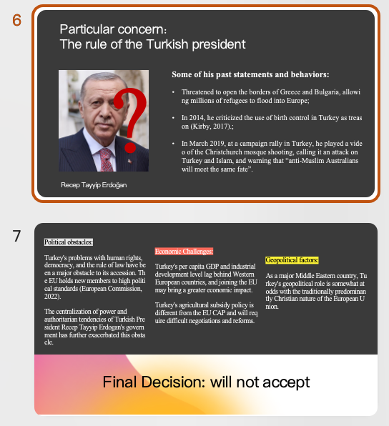
REC
Course: EU Politics and economy
Learn about the origins of the EU, its member states, its immediate goals and challenges, how decisions are made, and more.
An interesting class assignment: Discuss whether Turkey should be allowed to join the EU. We will be divided into different roles, including Turkey's representatives, the EU Commission, opponents and supporters, to present our views, and the Commission will make the final decision.
Evaluation: Small class size, easy to get high marks, a good choice for non-GAD students to broaden horizons.
4k
HD
00.00.03
RAW

Slide 4
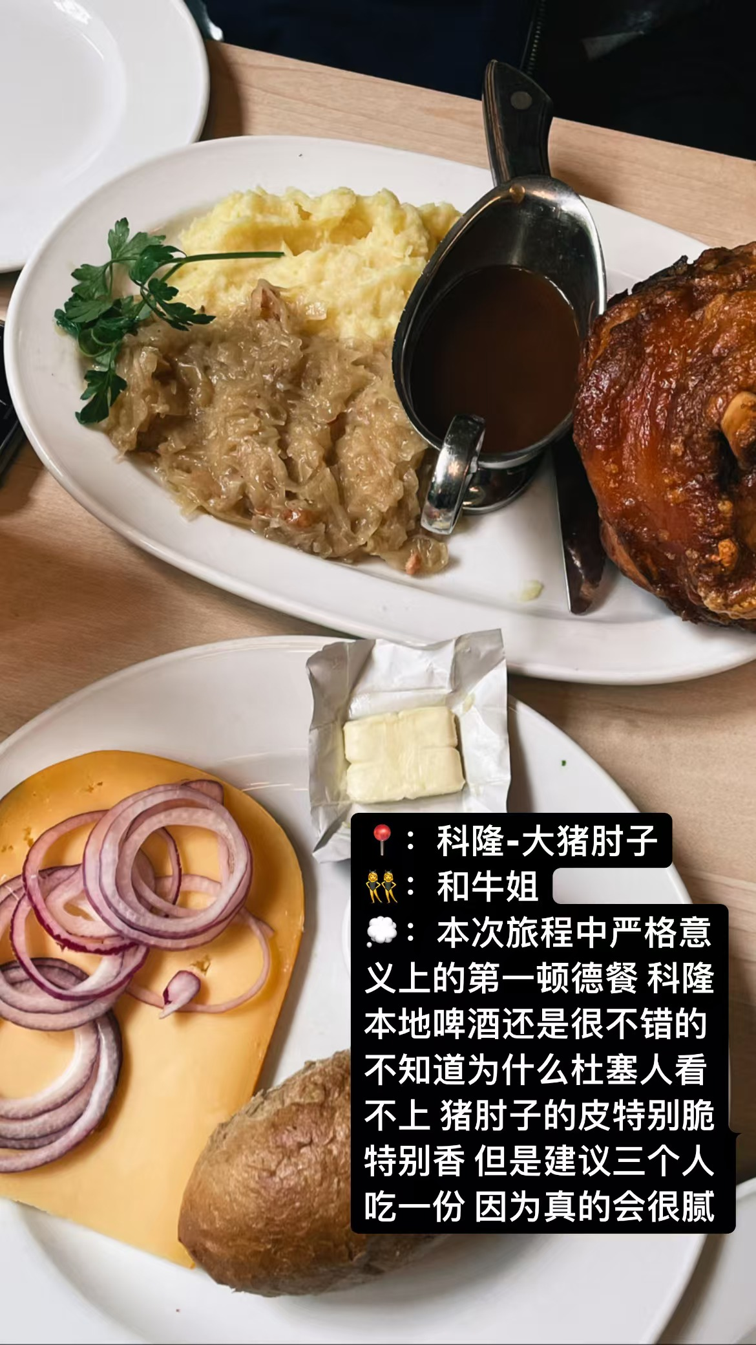
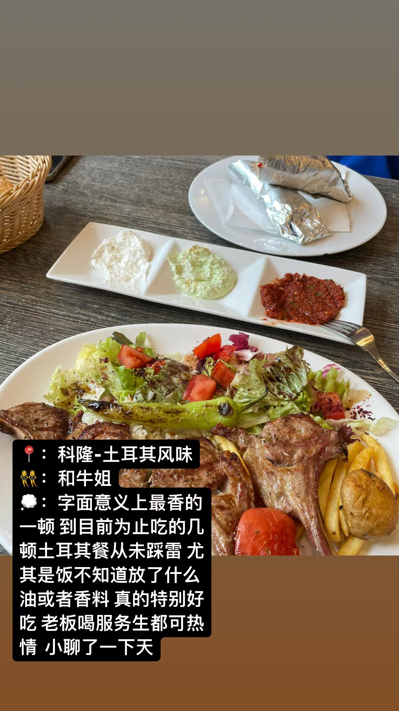
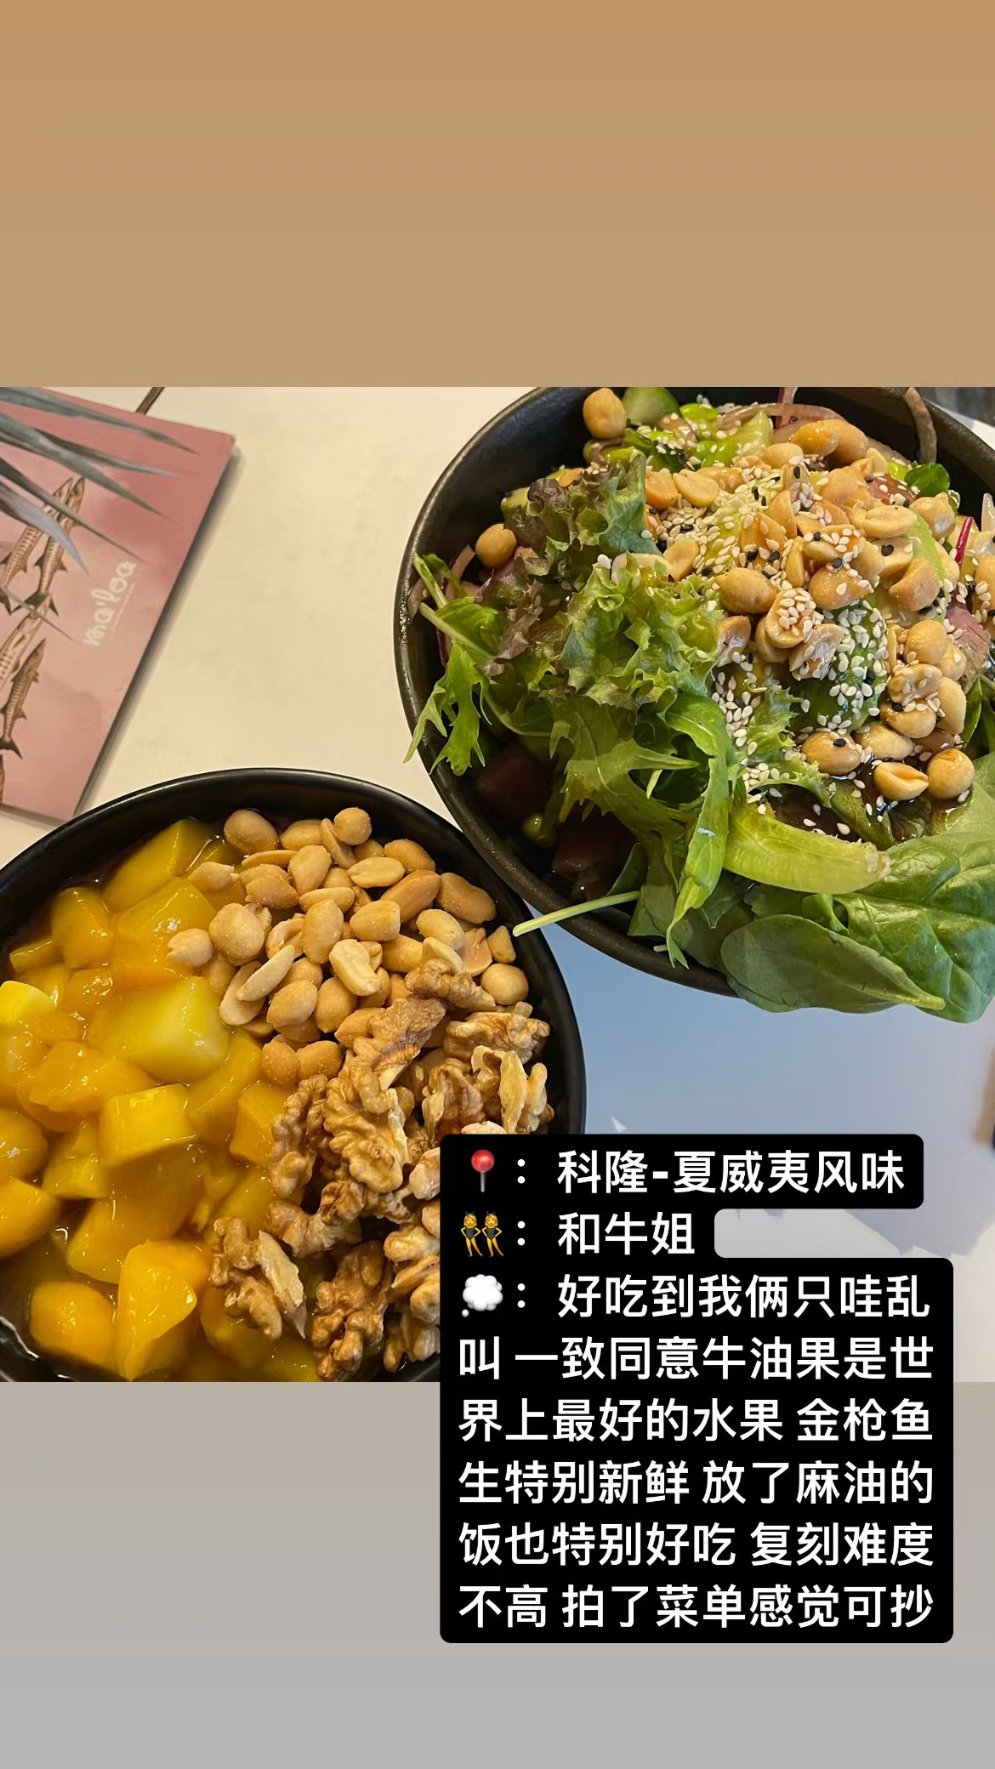

Life In Cologne-food & Drinks
REC
4k
Cuisines from different countries
top-notch cocktails and cheap beer available everywhere
HD
00.00.08
RAW

Slide 5
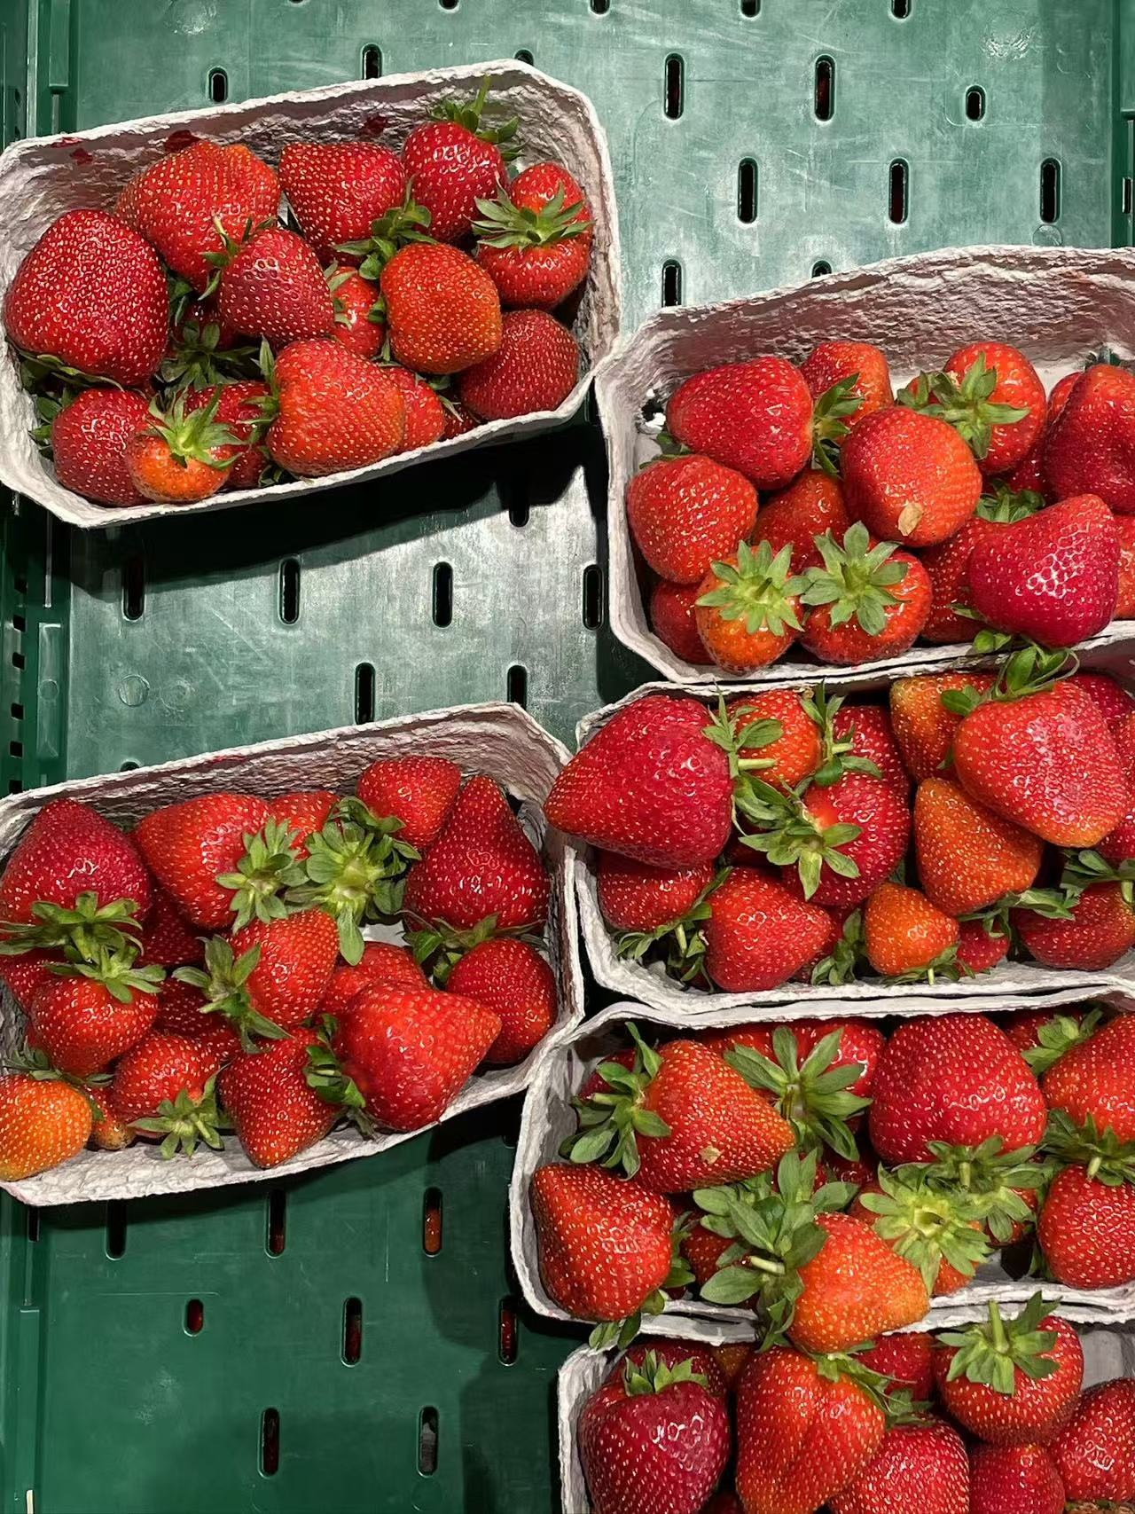
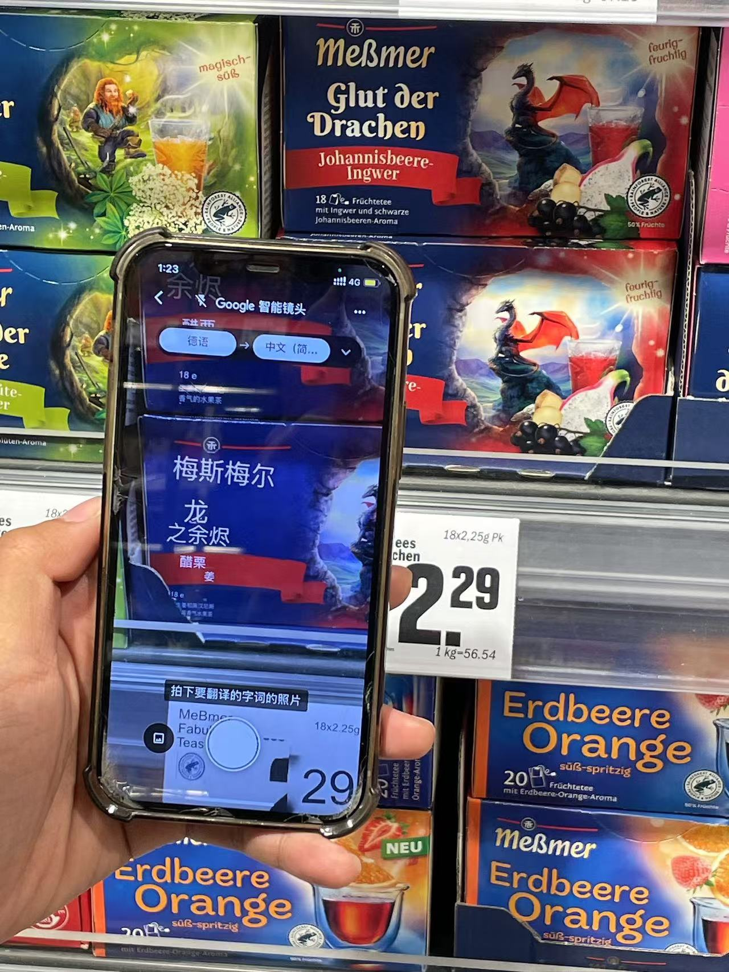
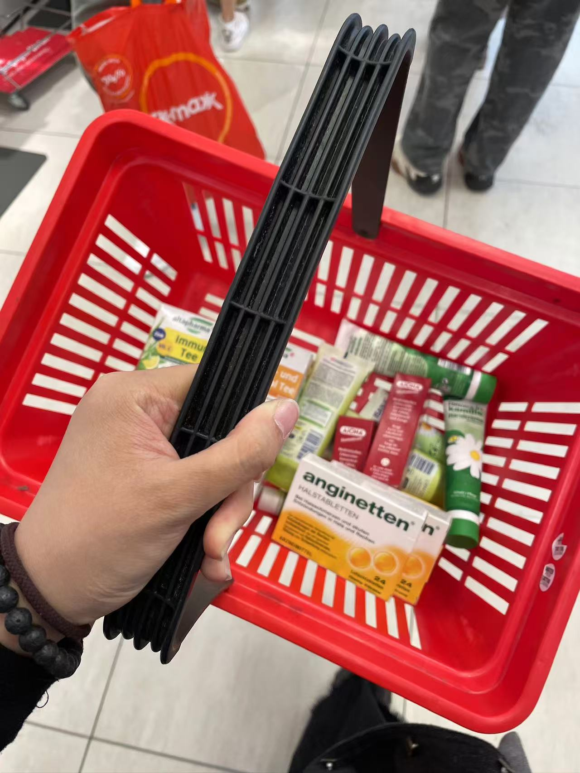
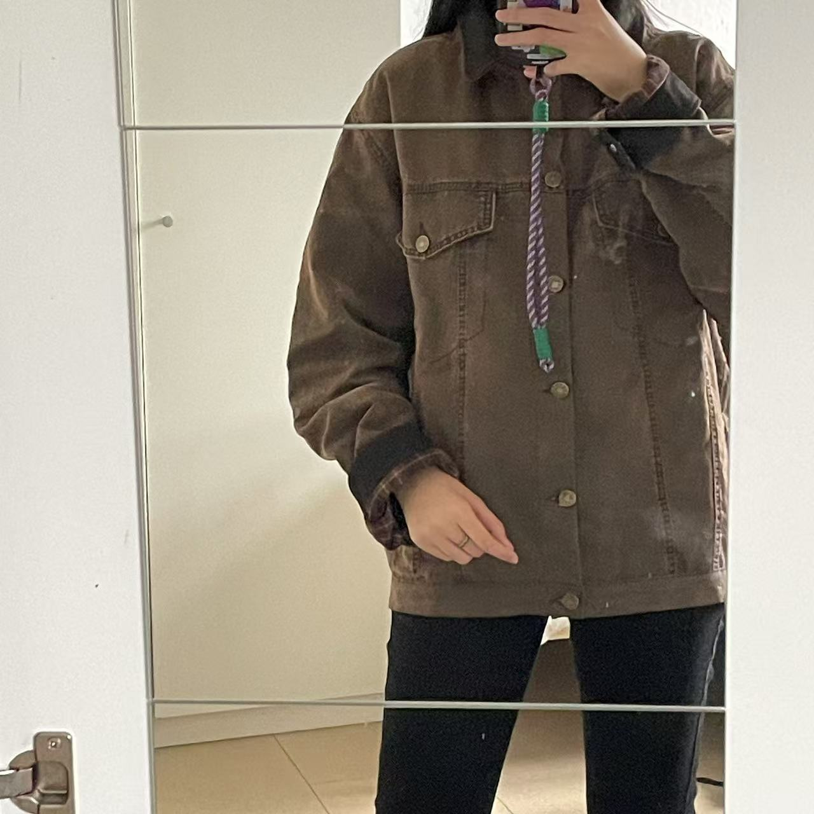
Life In Cologne-Shopping
REC
4k
Cheap strawberries, strange little things in the supermarket,
DM—the shop that can be addictive, Vintage and hunting clothes
HD
00.00.08
RAW

Slide 6
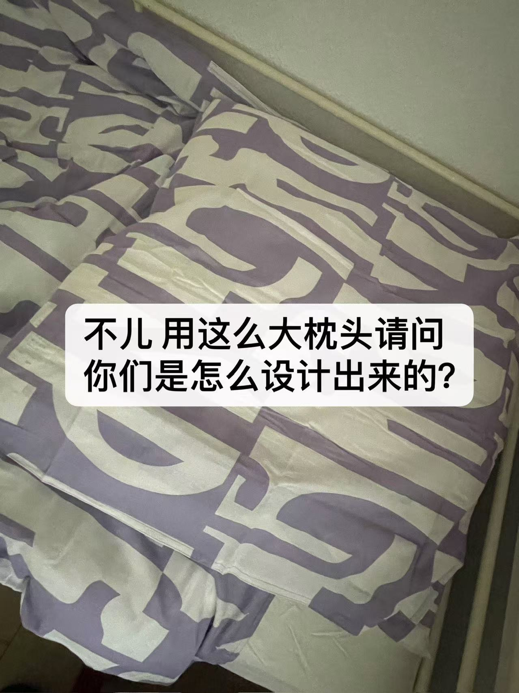
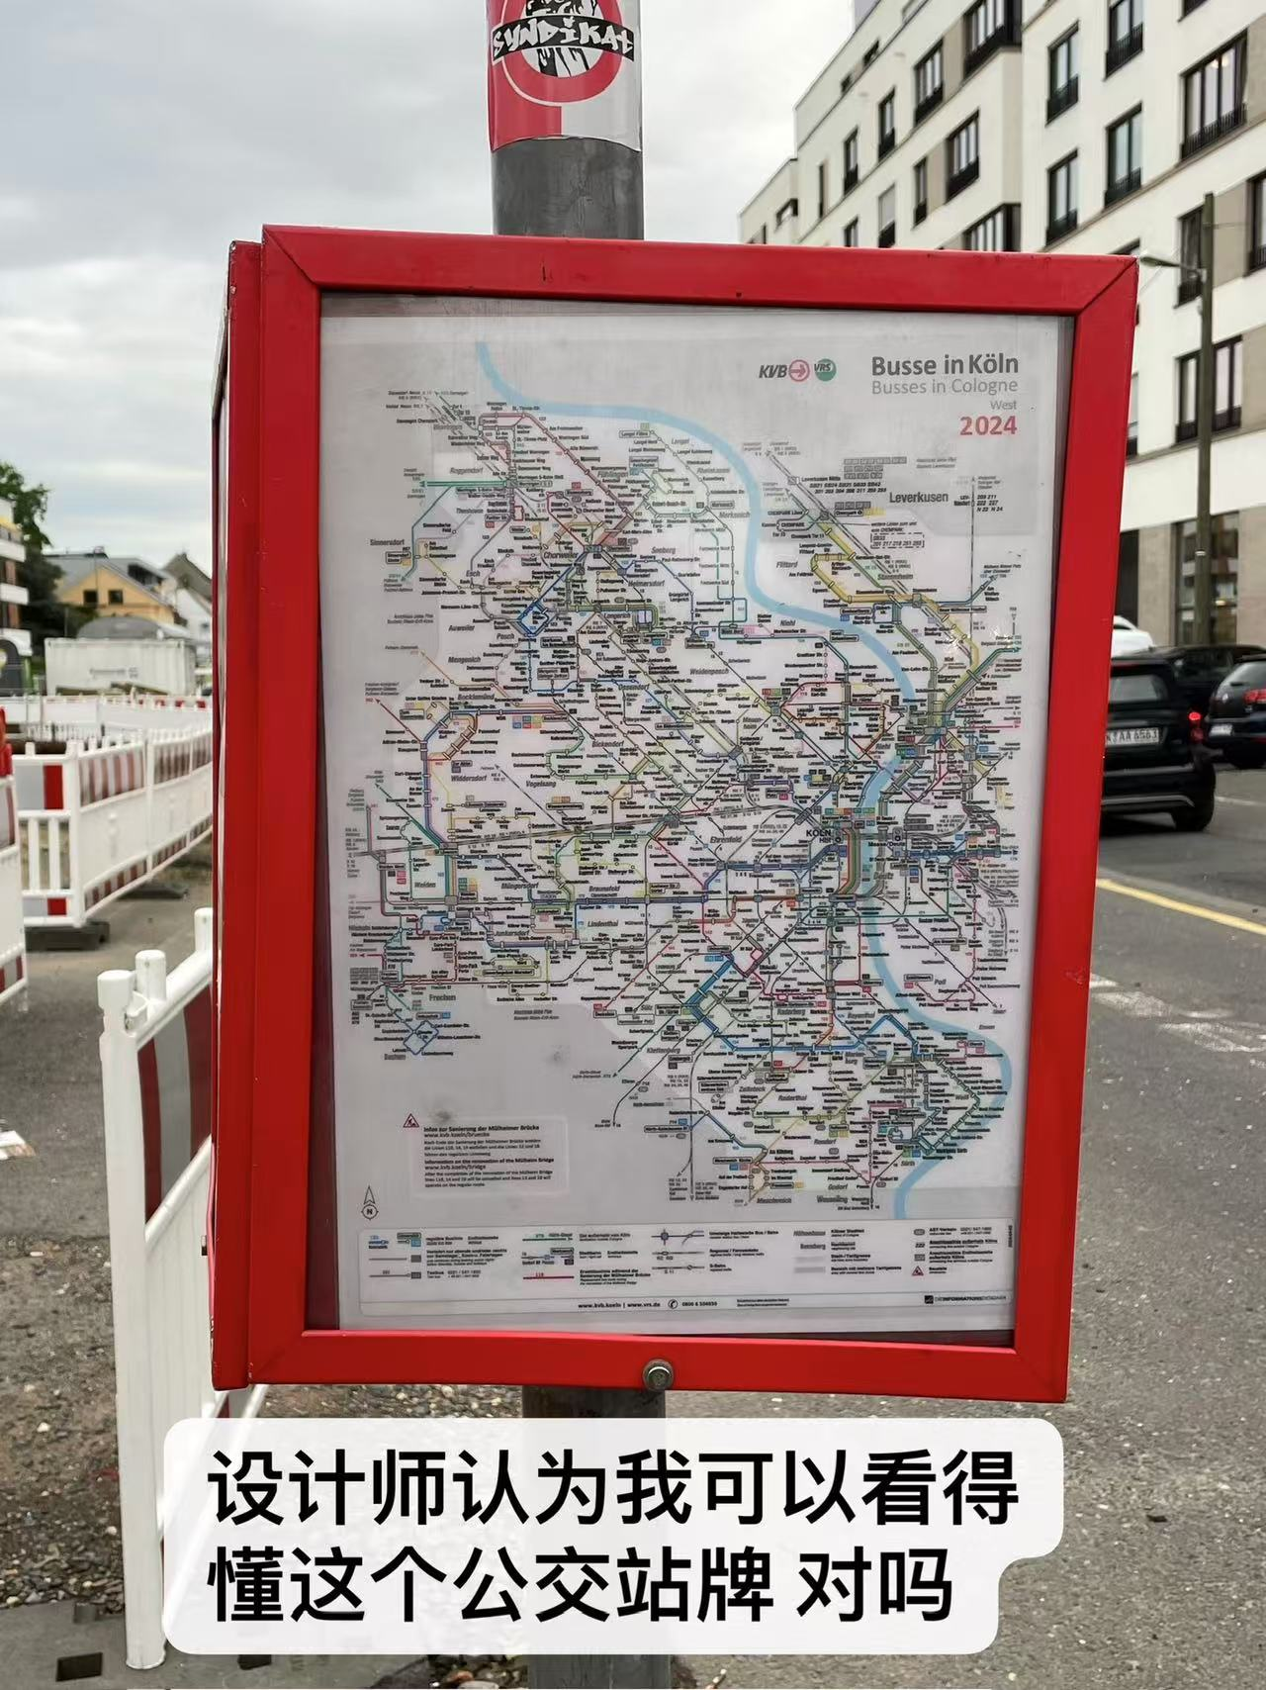
Life In Cologne-Accommodation and Transportation
REC
The dormitory is not far from the school, but it is a little distance from the city center. Overall, it was a good experience. You can cook for yourself.
Daily travel is usually through several different types of transportation, which is a bit complicated and requires downloading several apps, but it can be figured out with a little time.
* S; U; Bus; DB tickets; ICE…
4k
HD
00.00.08
RAW

Slide 7
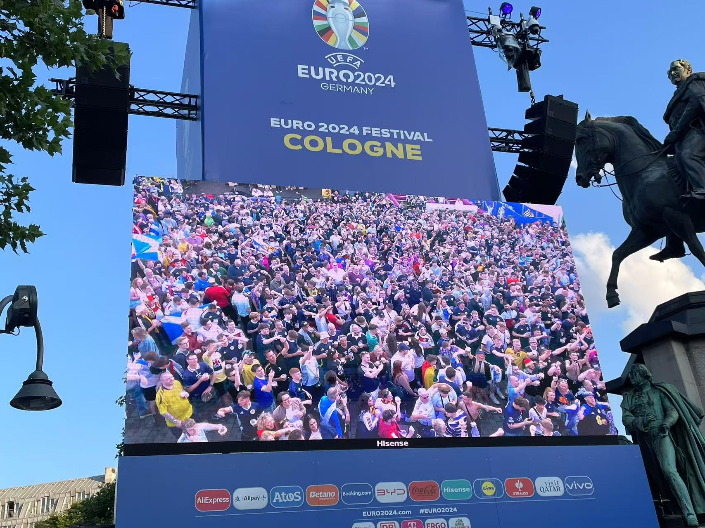
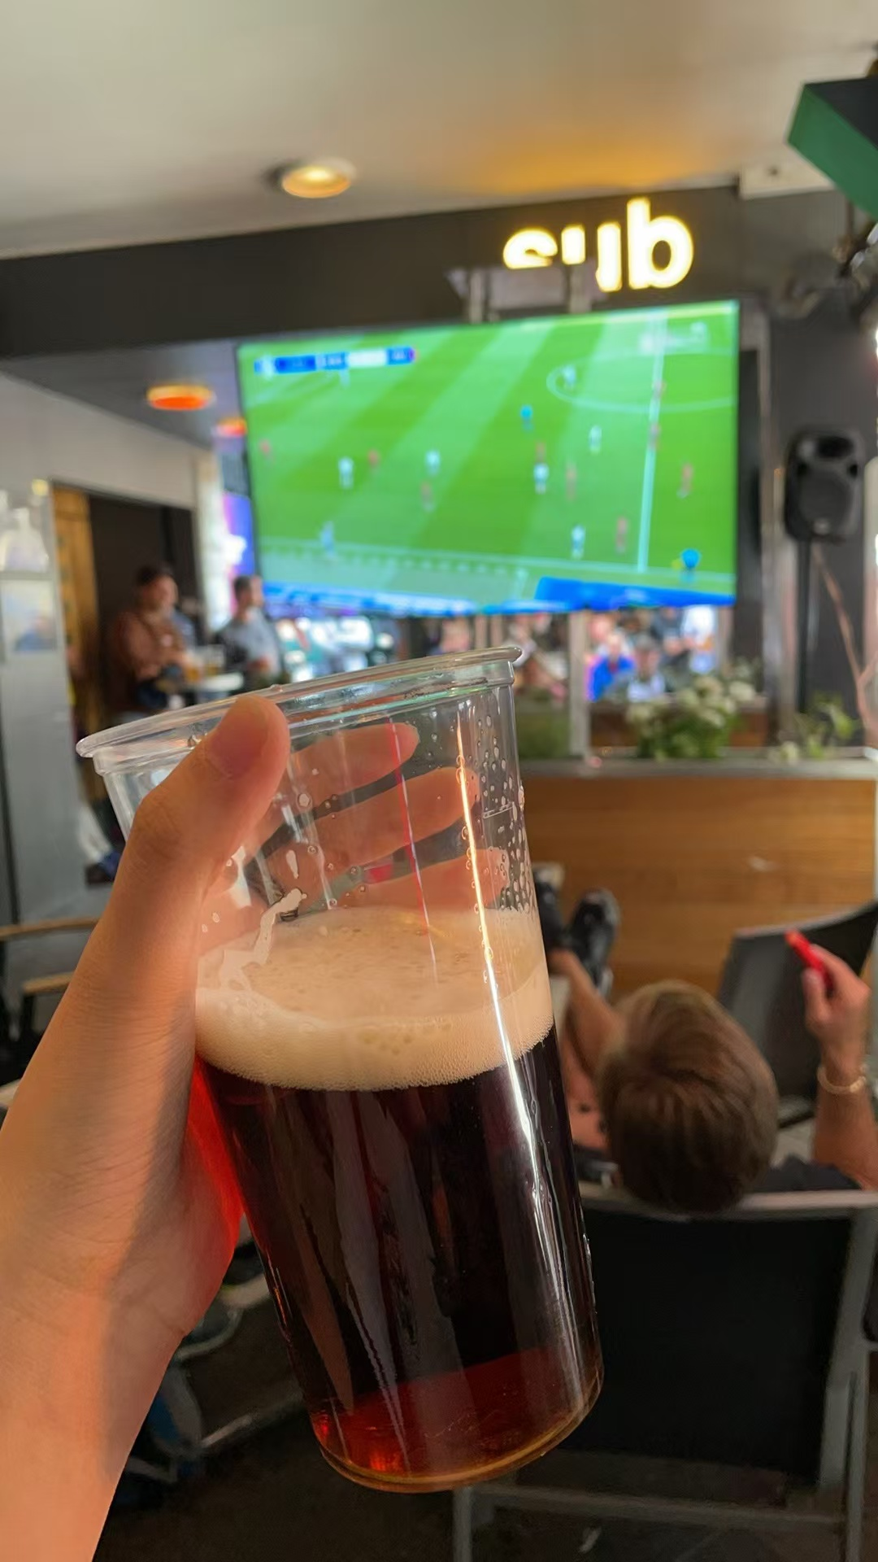
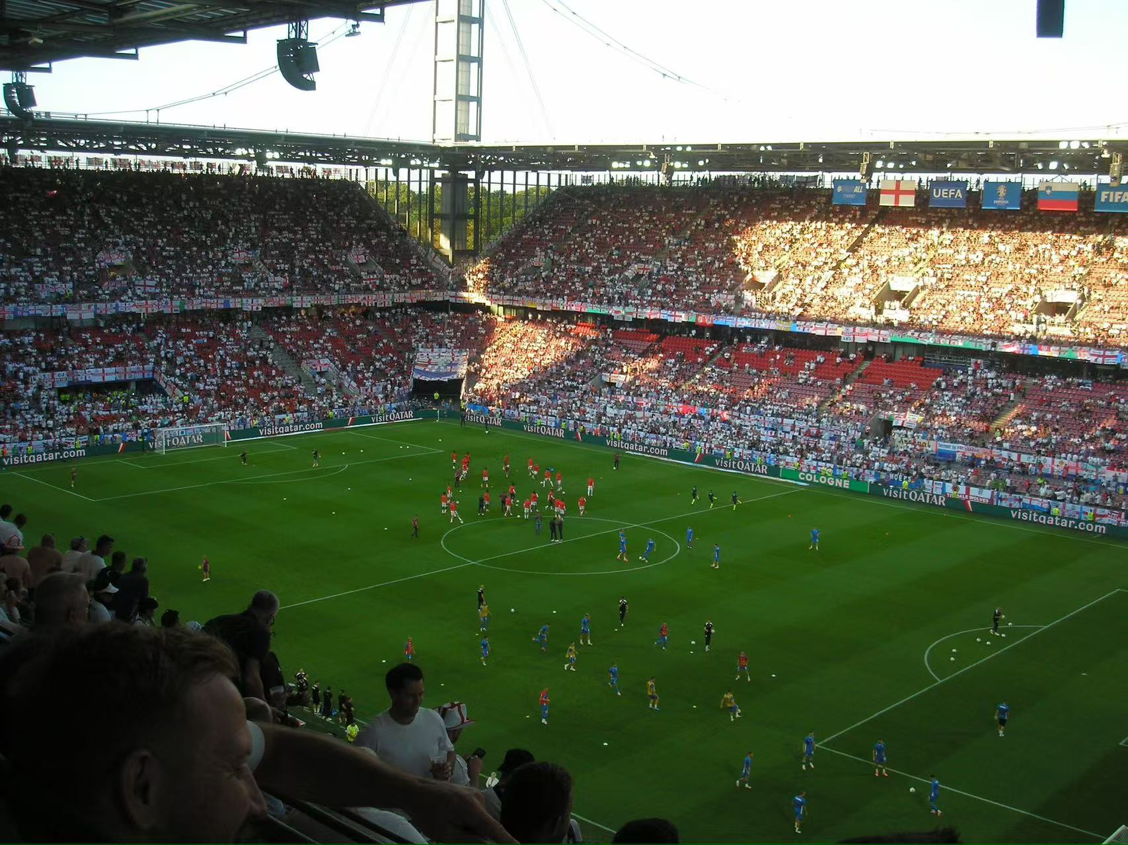
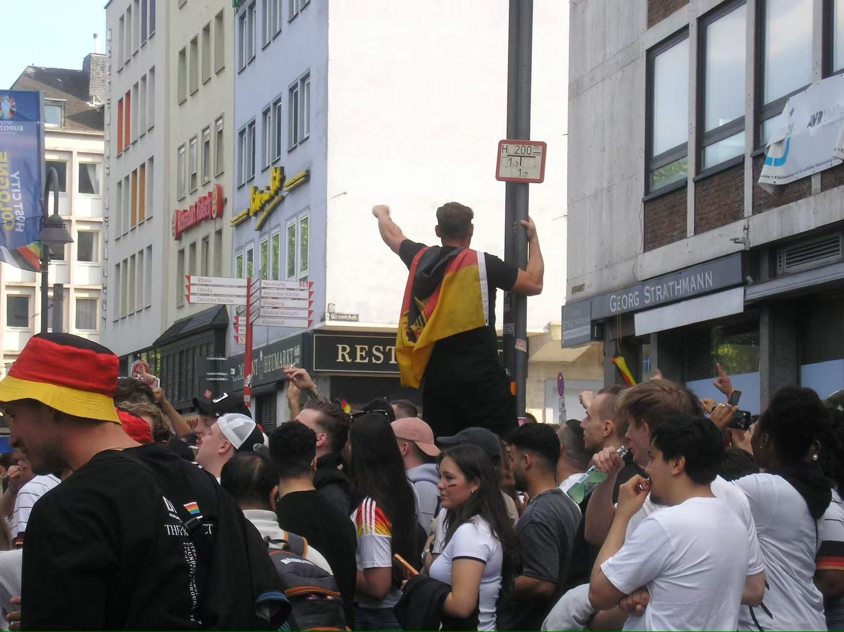
Life In Cologne-football
REC
4k
HD
00.00.08
RAW

Slide 8
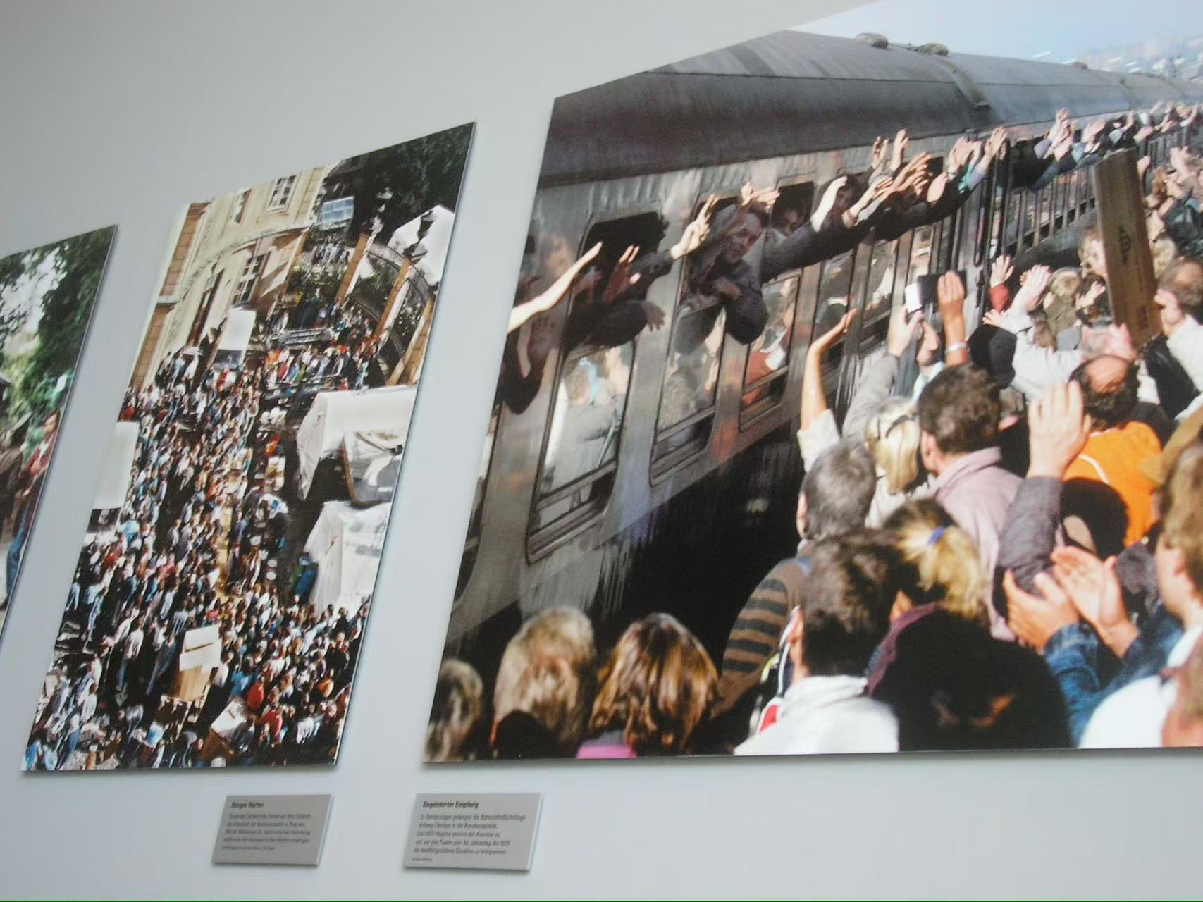
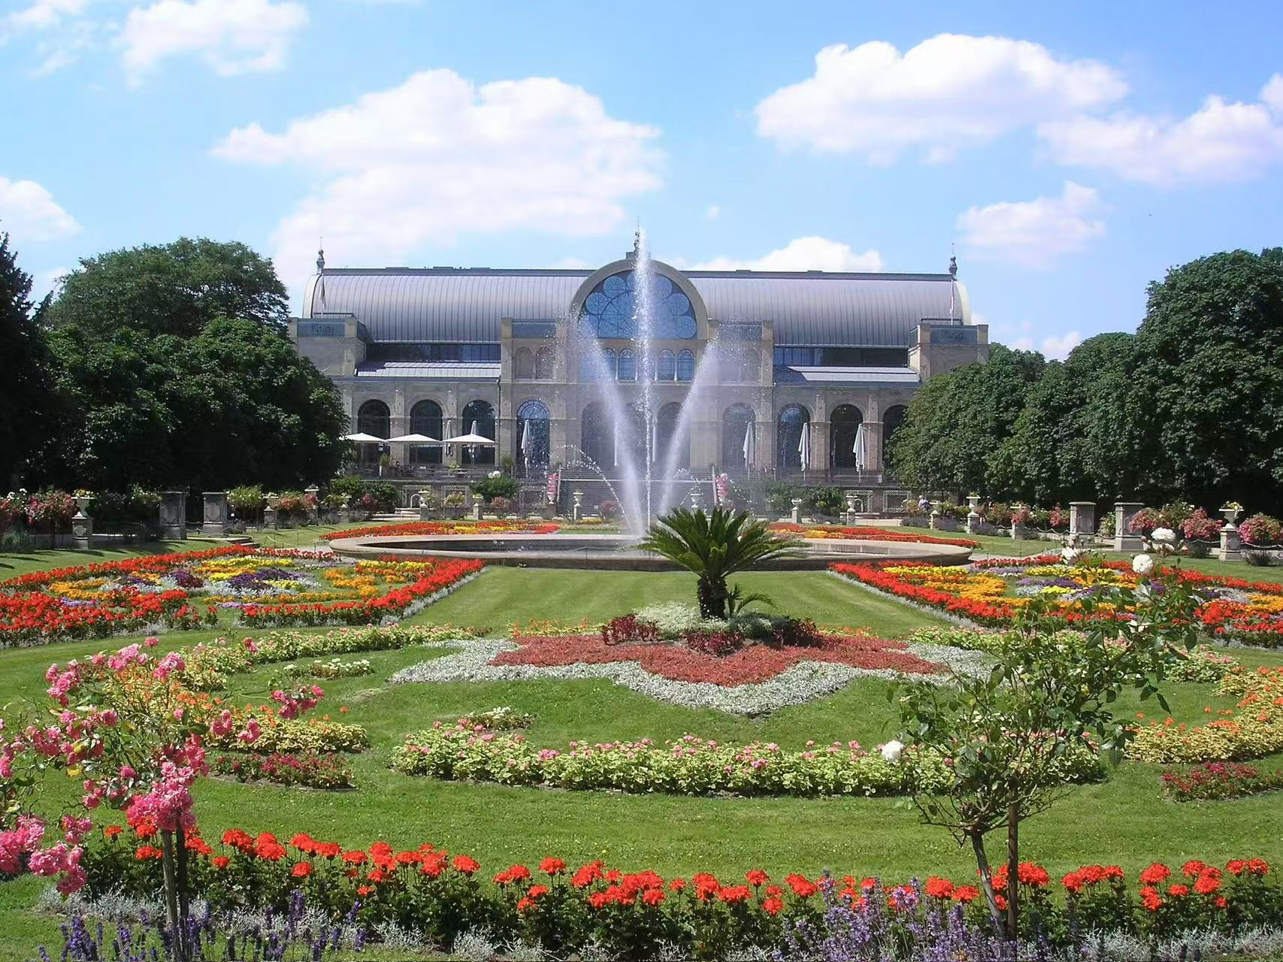
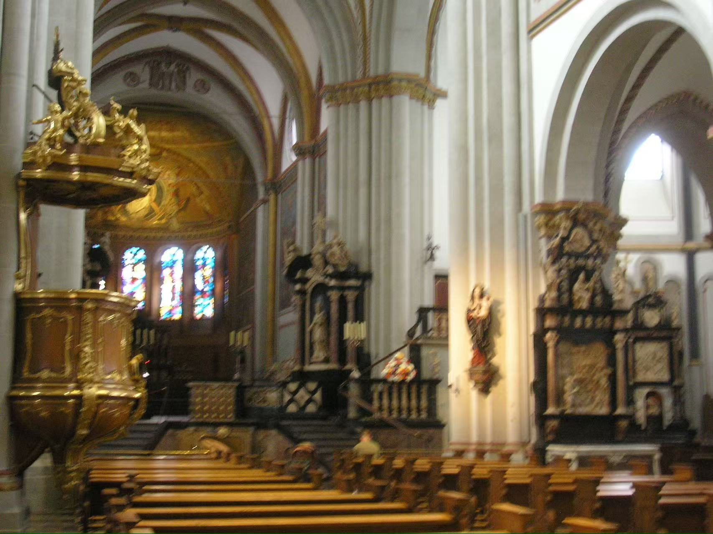
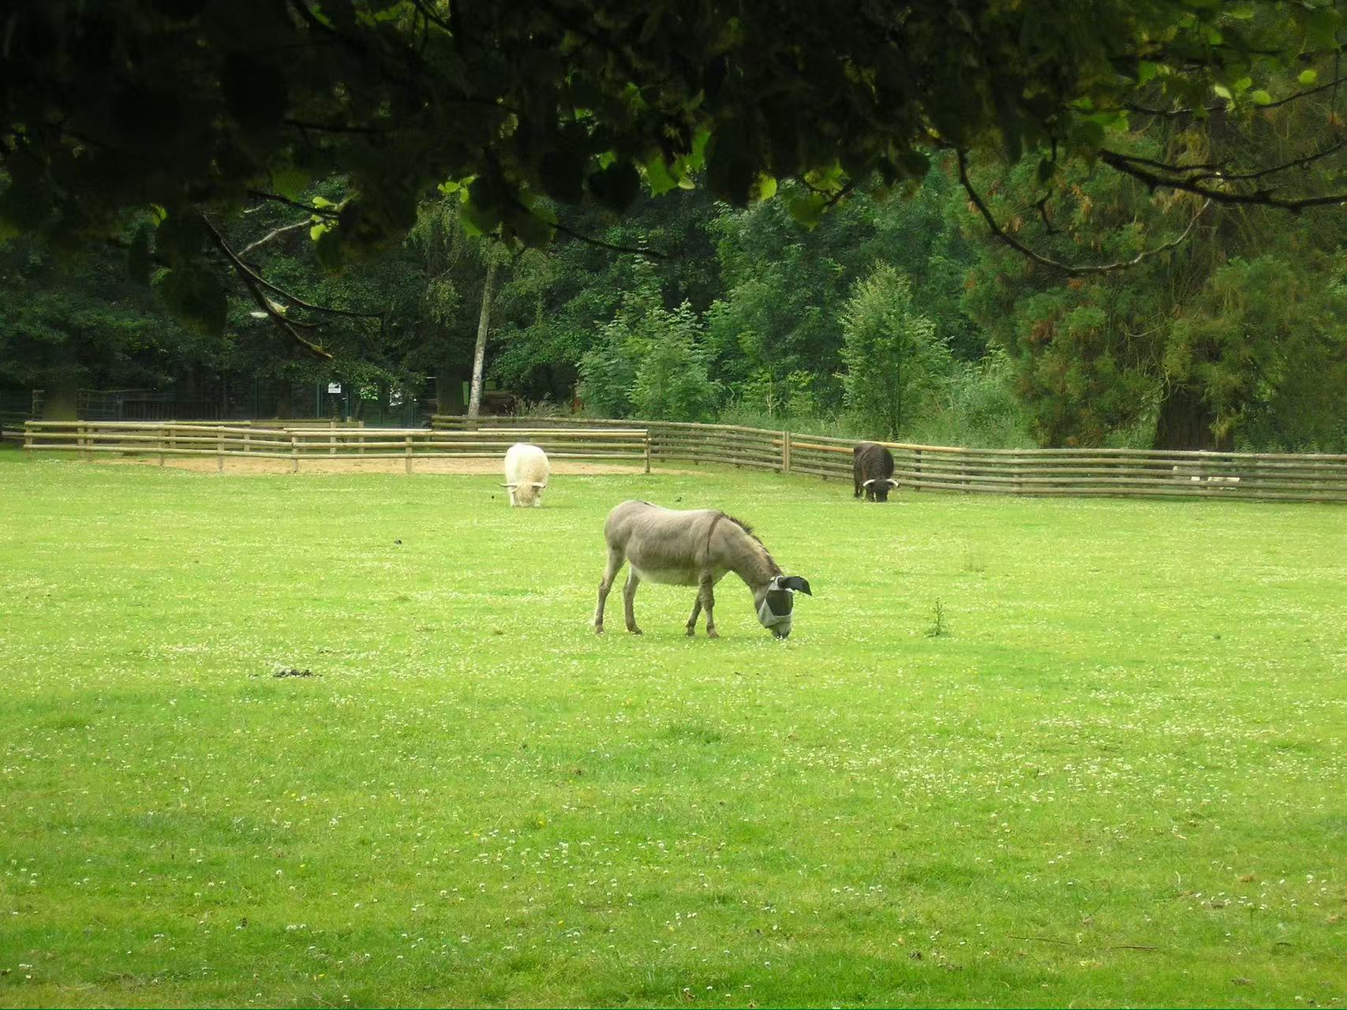
Travel through Germany
REC
4k
Attractions: Natural beauty and culture are both very rich
The weather in Germany is relatively best in June-July
which is very suitable for travel
HD
00.00.08
RAW

Slide 9
REC
Others
1. Start your visa appointment application as early as possible
2. Buy a good phone card in advance; Open an international credit card,
3. Buy a DB monthly ticket and check the transportation methods in Germany in advance
4. Pay attention to the temperature, compared with Guangdong, Germany is still relatively cold from June to July
5. Prepare cash, some stores cannot swipe cards, or they can only swipe cards after spending a certain amount
...
4k
HD
00.00.04
RAW

Slide 10

REC
THANK YOU
Wechat: TorpicalAkira
4k
HD
00.00.15
RAW

